Slide 1
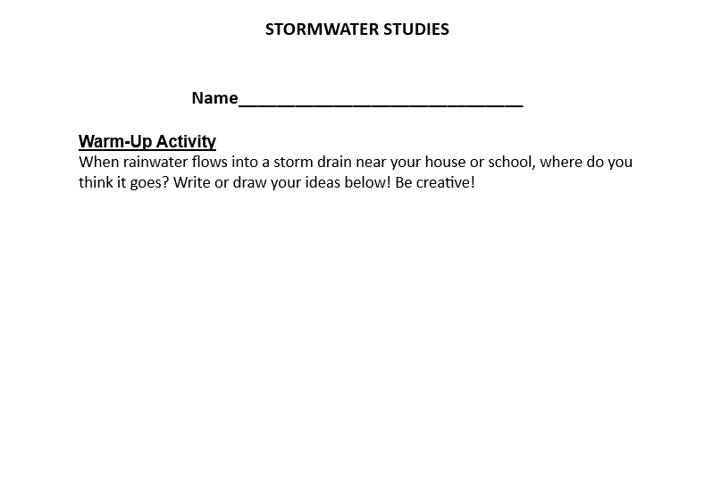
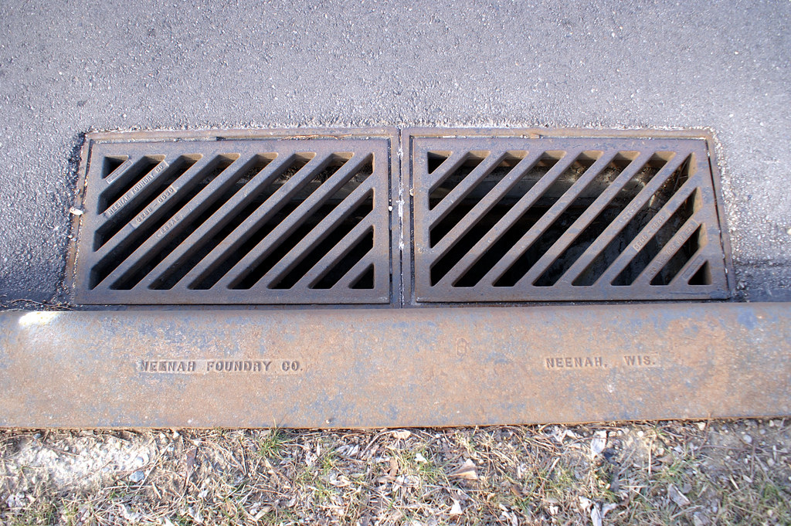

Warm Up
Where do you think the water that enters our storm drains goes?
Write or draw your ideas down in your journal.

Slide 2

One Water Program
Upper Deschutes Watershed Council

Slide 3
Essential Questions
What is stormwater, and how do human actions affect it?
How can we help keep our watershed clean from stormwater pollution?
What are some tools that can be used to clean or control our stormwater before it returns to the environment?

Slide 4

Check for understanding game!
Listen to the questions
Hold up the number on your hand you think the answer is.

Slide 5
Where does our drinking water come from?
Tumalo Creek
Prowell Springs/ Bridge Creek
Deschutes River

Slide 6
What is the name of the watershed we get our drinking water from?
Bend Municipal Watershed
Metolius Watershed
Upper Deschutes River Subbasin

Slide 7
Where is water used the most at our homes, schools, and businesses?
Outdoors for landscaping
Showers
Toilets

Slide 8
Where does our used water go after it goes down the drain in our house?
Back to our rivers and streams
Water Reclamation Facility
Water storage reservoir

Slide 9
How does water get returned to the environment at the Water Reclamation Facility?
Evaporation and percolation
It gets piped to Bridge Creek
It goes directly into our rivers and streams

Slide 10
Can human activity have an impact on our water?
Yes
No
Not sure
(Positive or negative!)

Slide 11
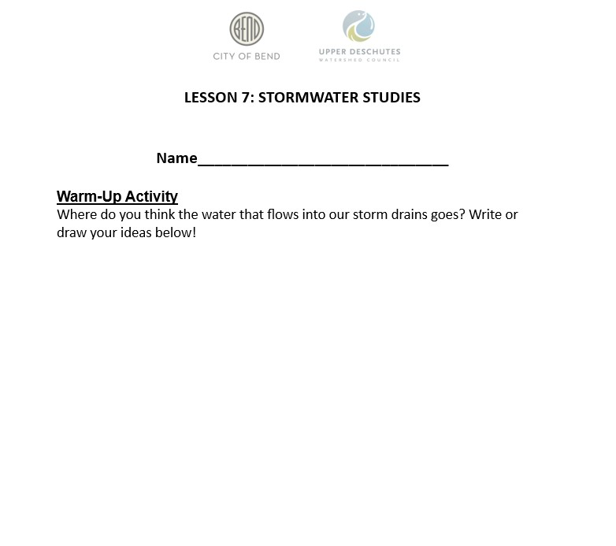
Warm Up
Where do you think the water that enters our storm drains goes?
Find someone who…

Slide 12
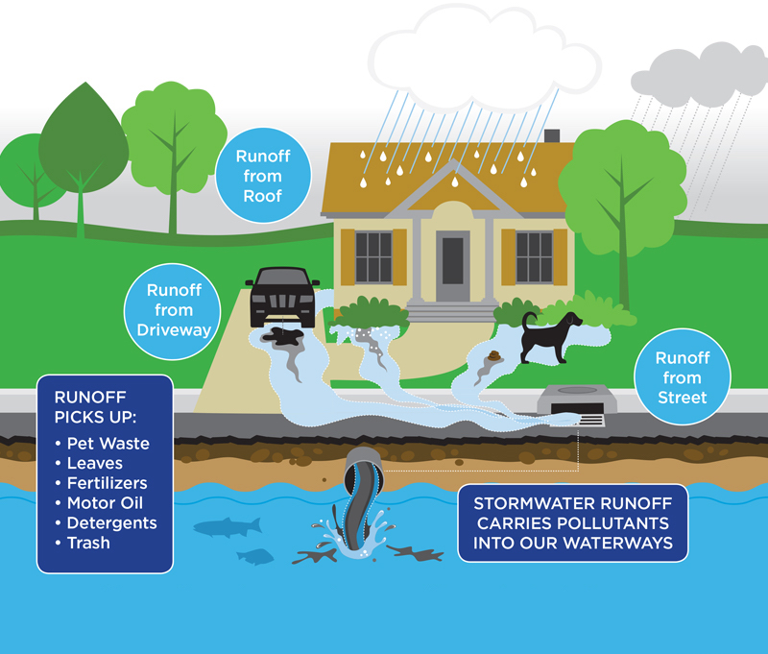
What is stormwater?
Any water that collects on and runs off the land and eventually makes its way into our surface water and groundwater through a stormwater collection system or over land.

Slide 13
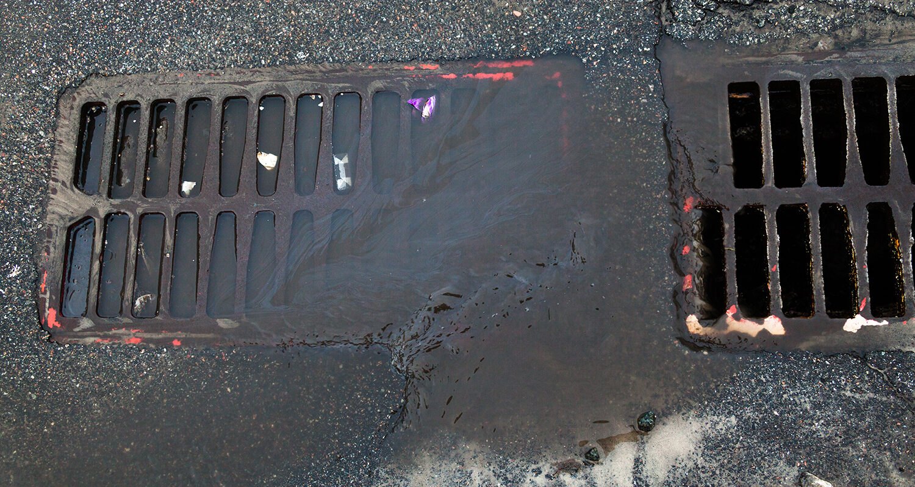
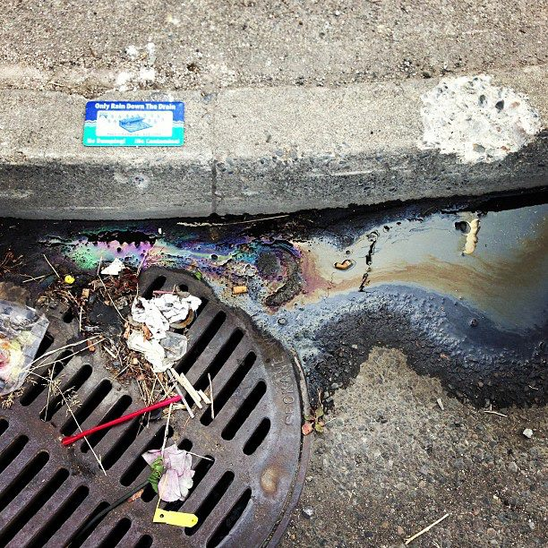
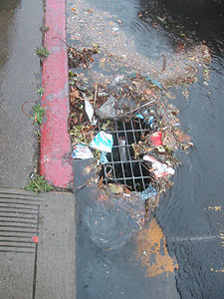
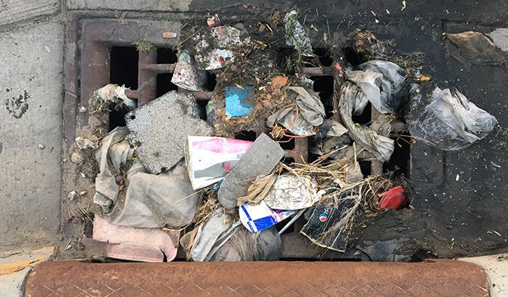
Stormwater can be polluted…

Slide 14
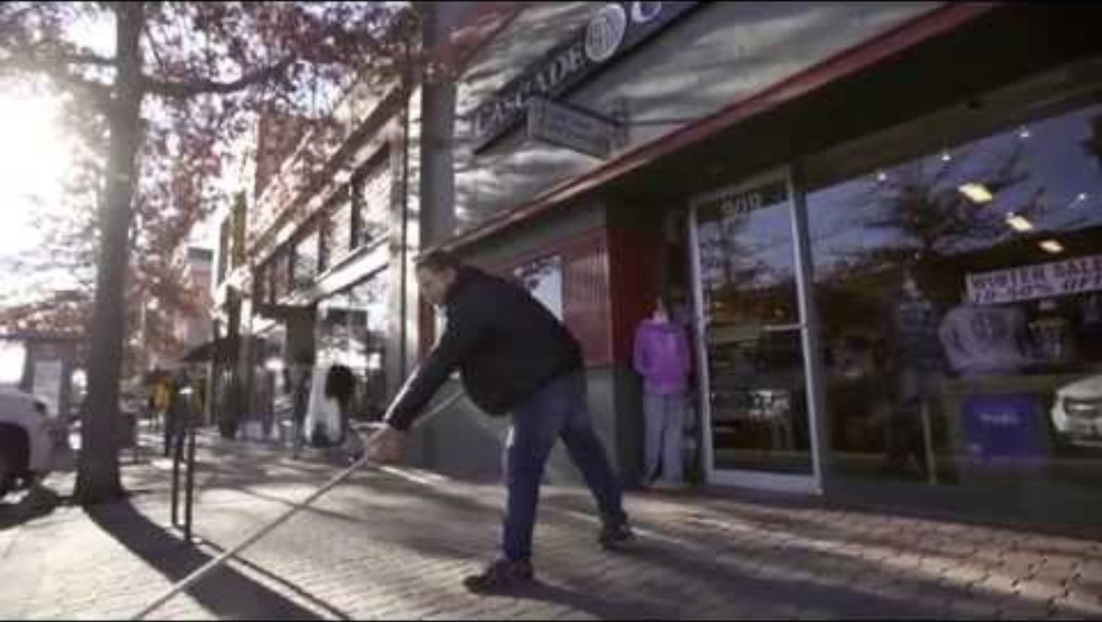
Bend Downtown Stormwater

Slide 15
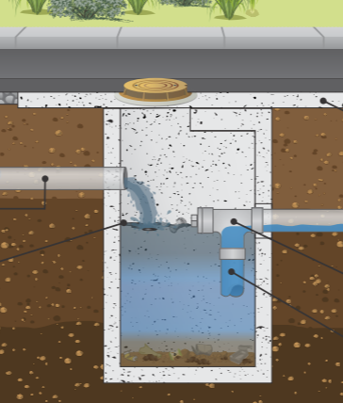
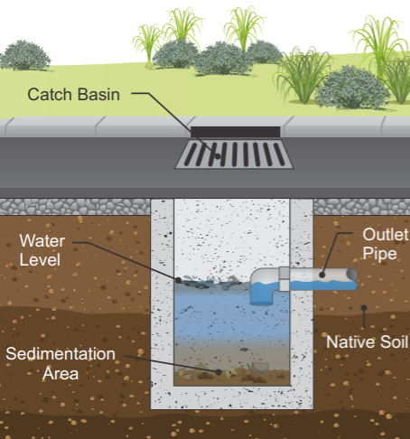
Stormwater Infrastructure
Catch Basin
Sedimentation Manhole

Slide 16
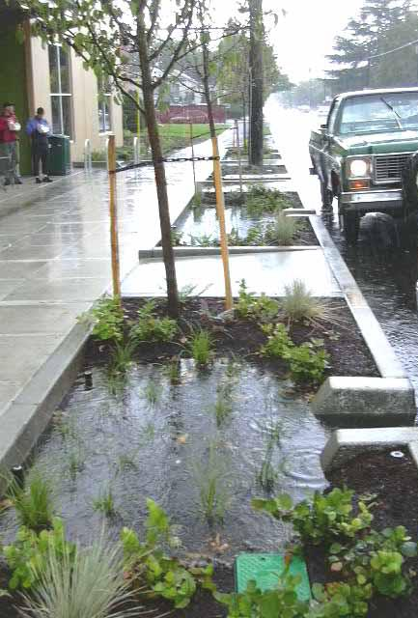
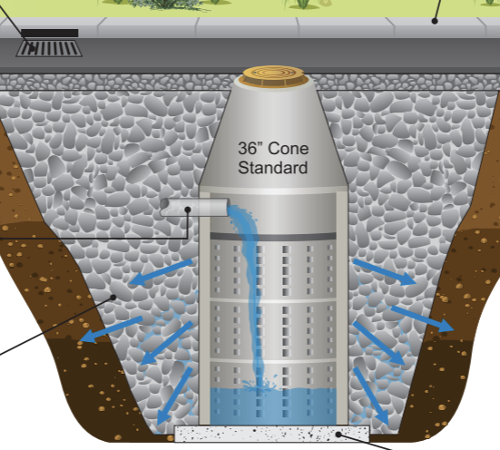
Stormwater Infrastructure
Drywell
Planters

Slide 17
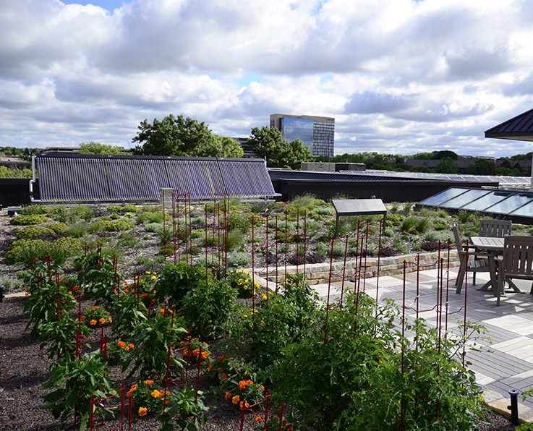
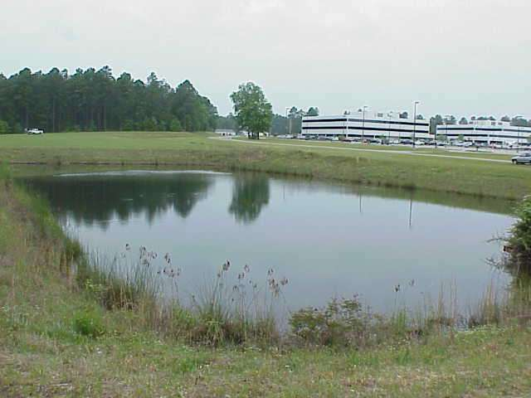
Stormwater Infrastructure
Green Roofs
Retention Ponds

Slide 18
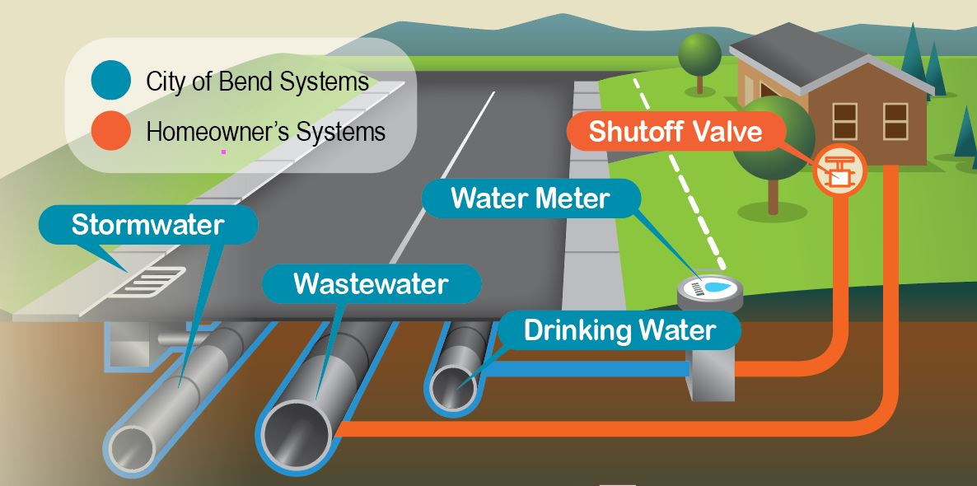

Slide 19
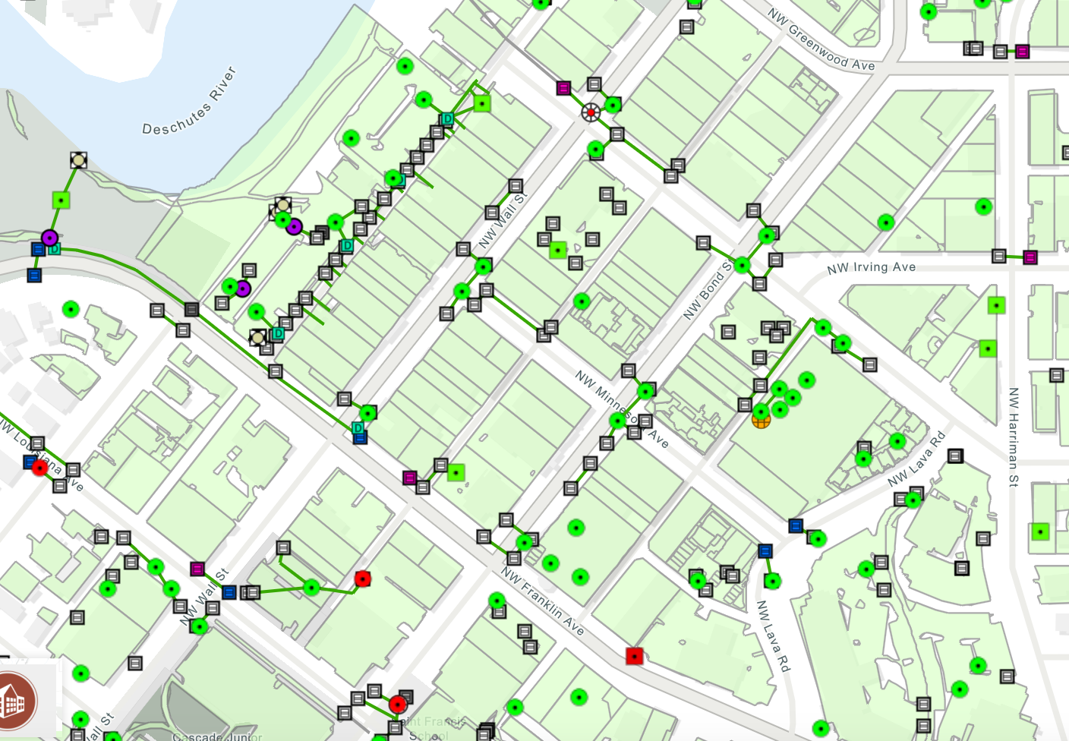
Stormwater facilities around downtown Bend!
Interactive Stormwater Map

Slide 20
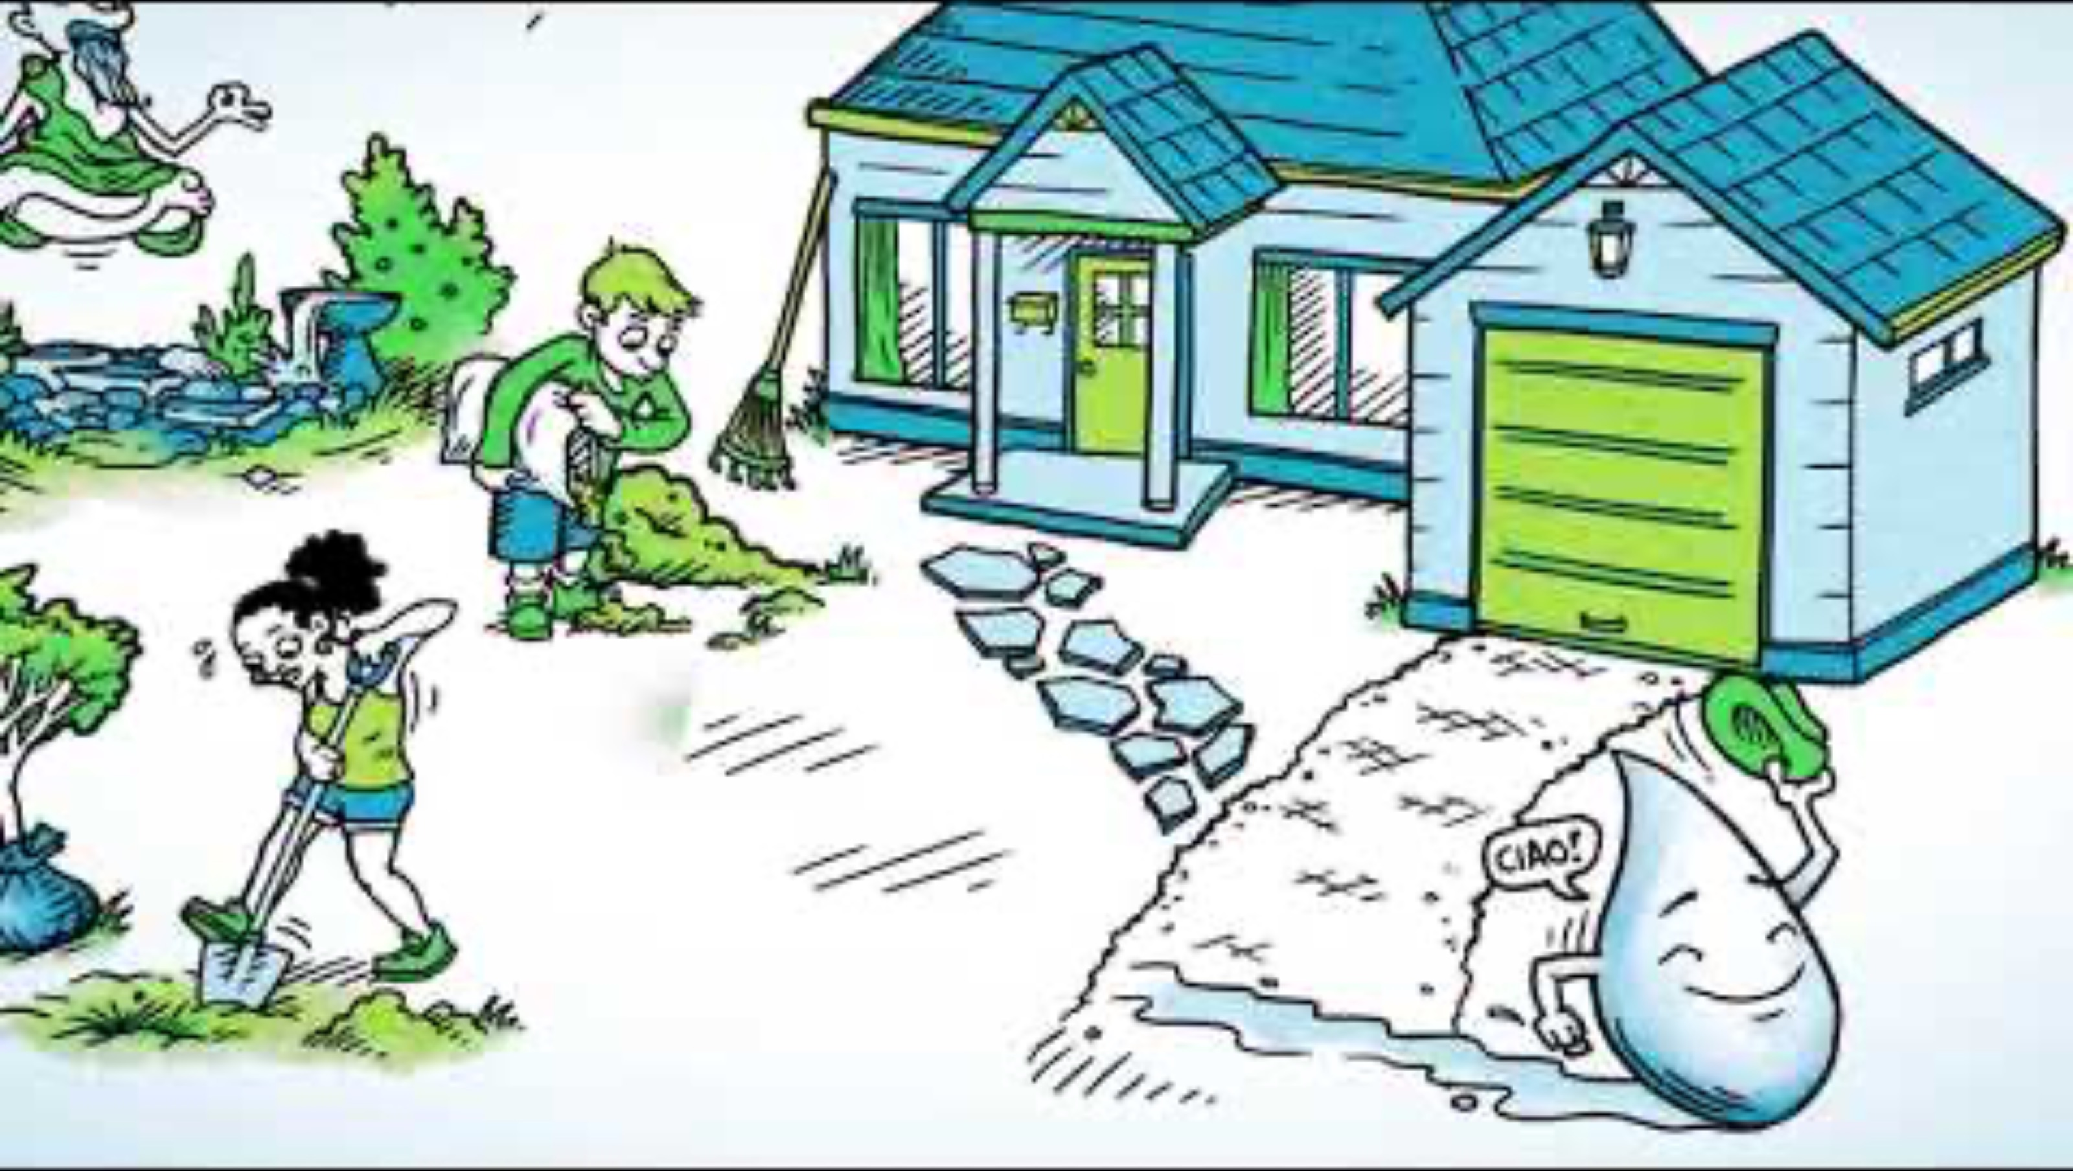
Managing Stormwater Runoff

Slide 21
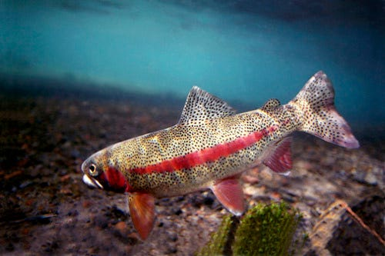
Let’s check out Taylor the Trout and some stormwater challenges!

Slide 22
Essential Questions
What is stormwater, and how do human actions affect it?
How can we help keep our watershed clean from stormwater pollution?
What are some tools that can be used to clean or control our stormwater before it returns to the environment?

Slide 23
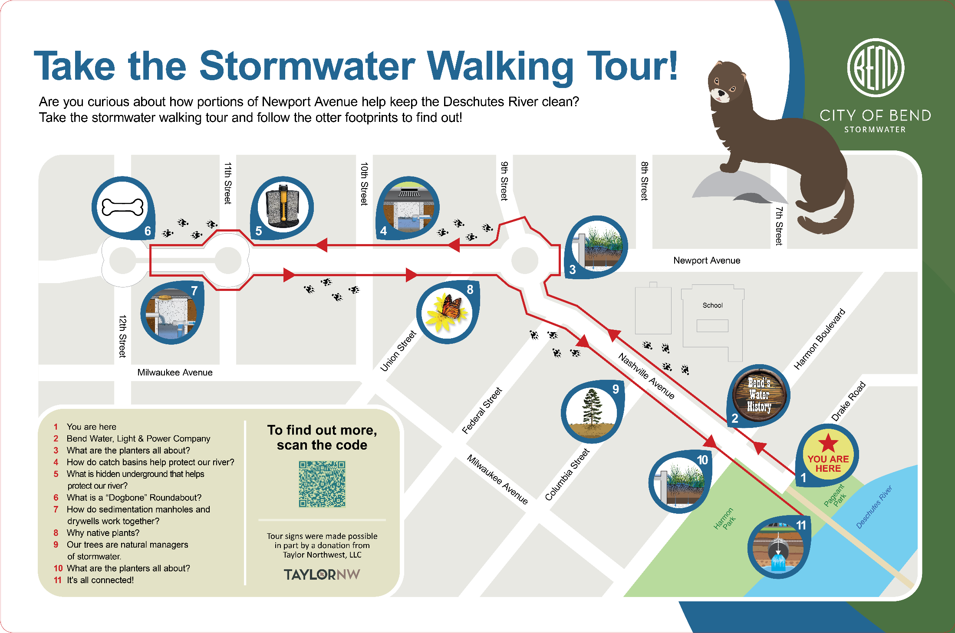
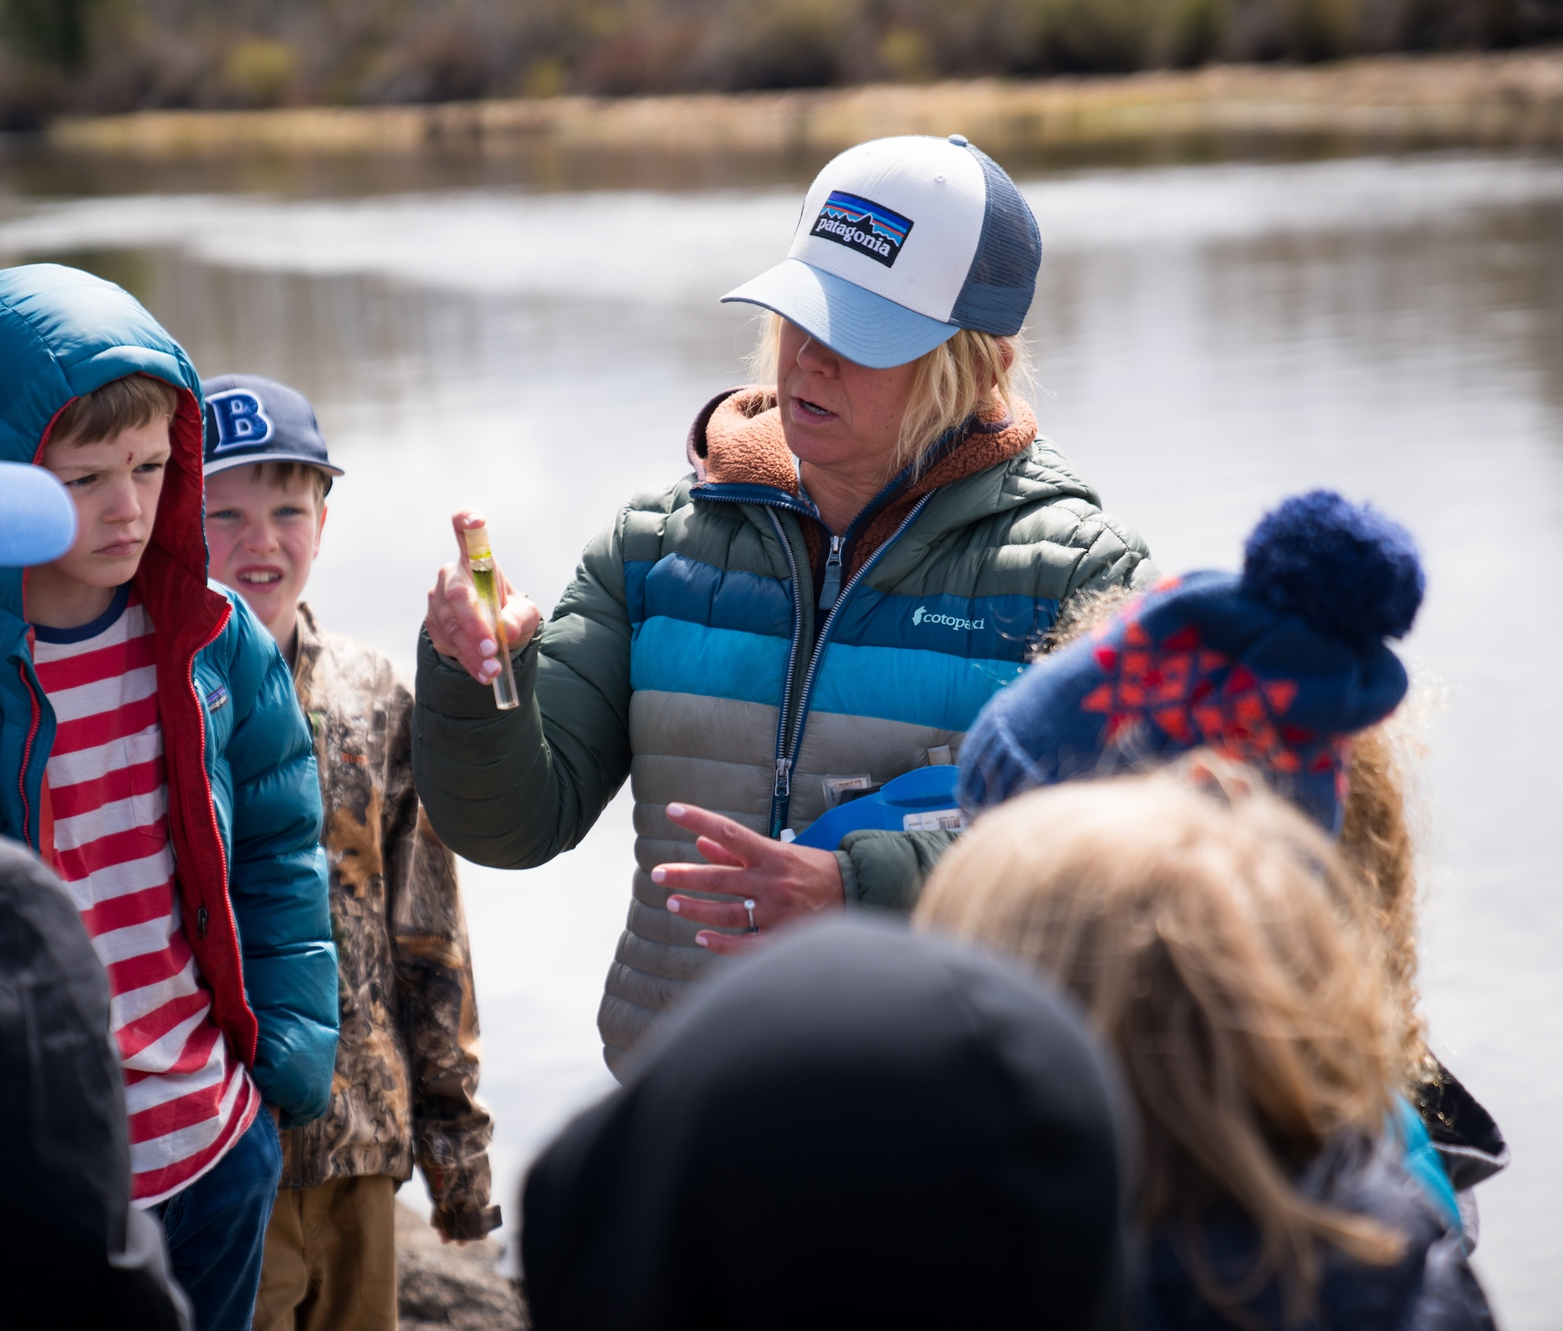
Next Lesson: Newport Avenue Stormwater Tour and Water Quality Testing!

