Slide 1

Warm Up
Which materials do you think can safely go down the drains in our homes, schools, and businesses? What should NOT go down the drain? Why do you think only certain materials should go down the drain?
Write or draw down your ideas in your journal!

Slide 2

One Water Program
Upper Deschutes Watershed Council

Slide 3
Essential Questions
What is wastewater?
How can our daily choices affect wastewater quality and treatment?
How can responsible wastewater management help protect our water resources?

Slide 4
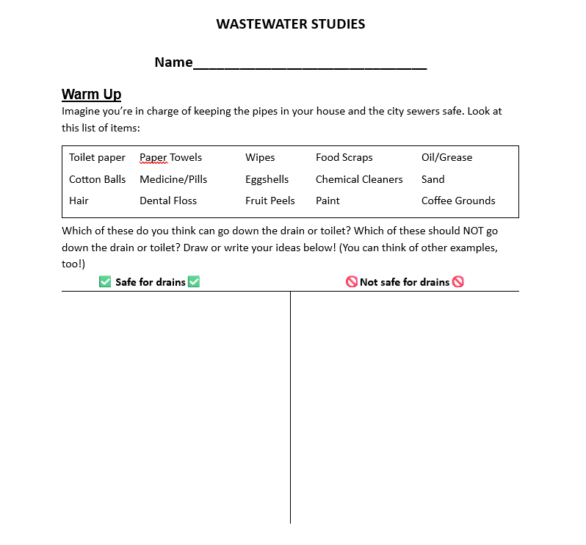
Stand up, hand up, pair up!
Which materials do you think can safely go down the drains in our homes, schools, and businesses?
Find a buddy!

Slide 5
Stand up, hand up, pair up!
Which materials do you think should not go down the drain?
Find a buddy!

Slide 6
Stand up, hand up, pair up!
Why do you think only certain materials are okay?
Find a new buddy!

Slide 7

What can go down our drains?
Which materials do you think can safely go down the drains in our homes, schools, and businesses?
3 Ps: Pee, Poop, (toilet) Paper
Which materials do you think should not go down the drain?
FOGs: Fats, Oils, Grease
Food
Trash
Wipes
Pharmaceuticals
Harsh cleaning products
Why do you think only certain materials are okay?
What we put down the drain impacts the water quality of the water returning to the environment!

Slide 8
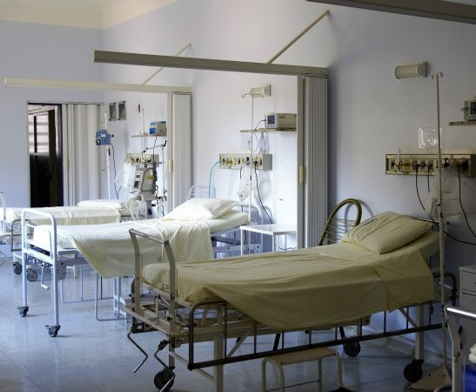
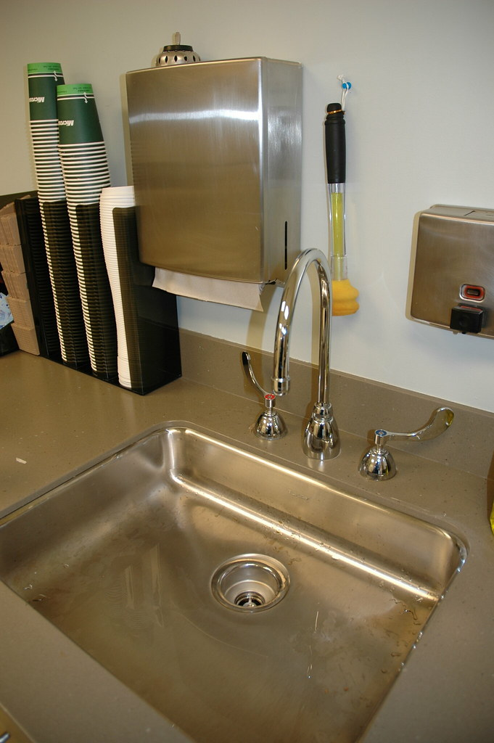
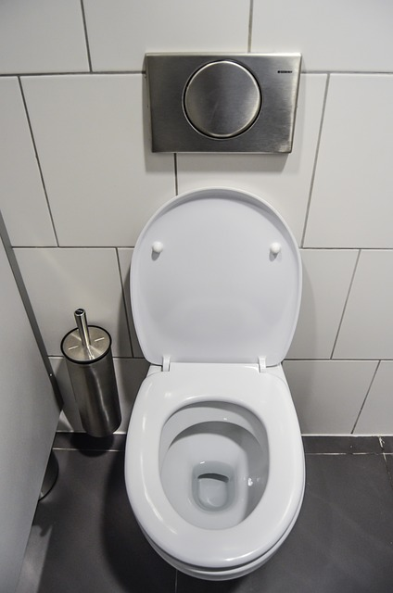
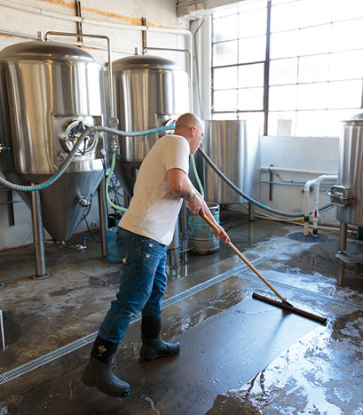
What is wastewater?
All the used water (sometimes called sewage) that flows down indoor drains in homes, schools, and businesses.

Slide 9
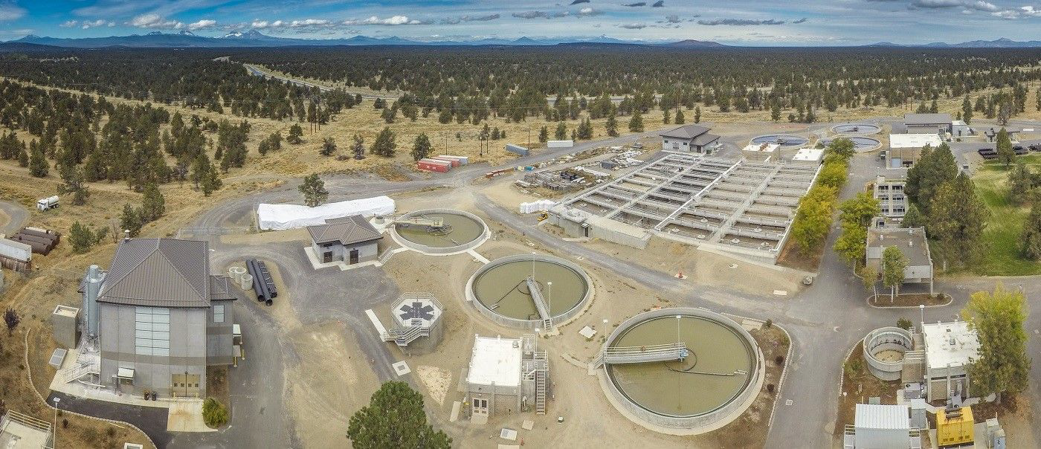
It all ends up at… the Water Reclamation Facility!

Slide 10
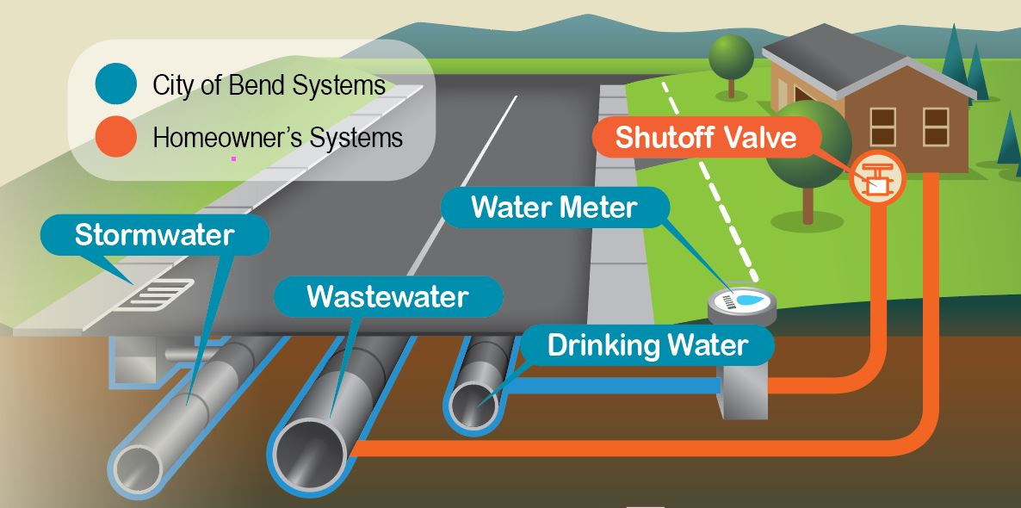
Clean out
FOGs

Slide 11
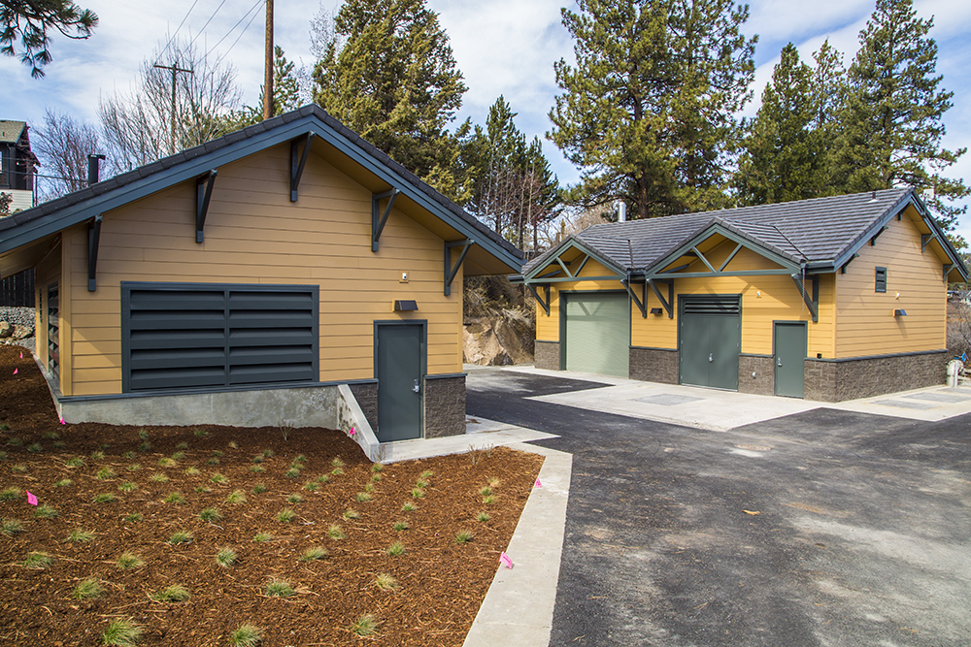
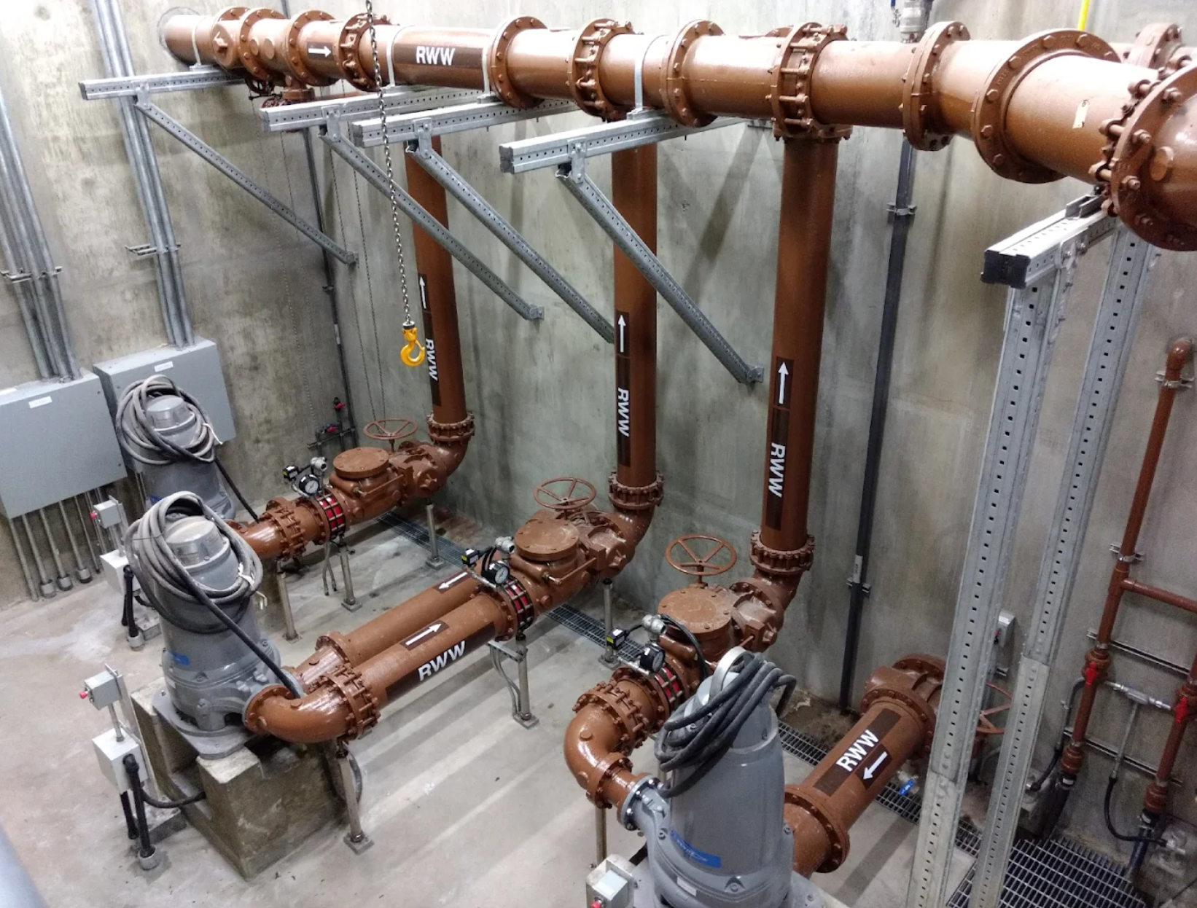
Colorado sewer lift station
(right near the Bend whitewater park!)
Why does sewage need to be lifted?

Slide 12
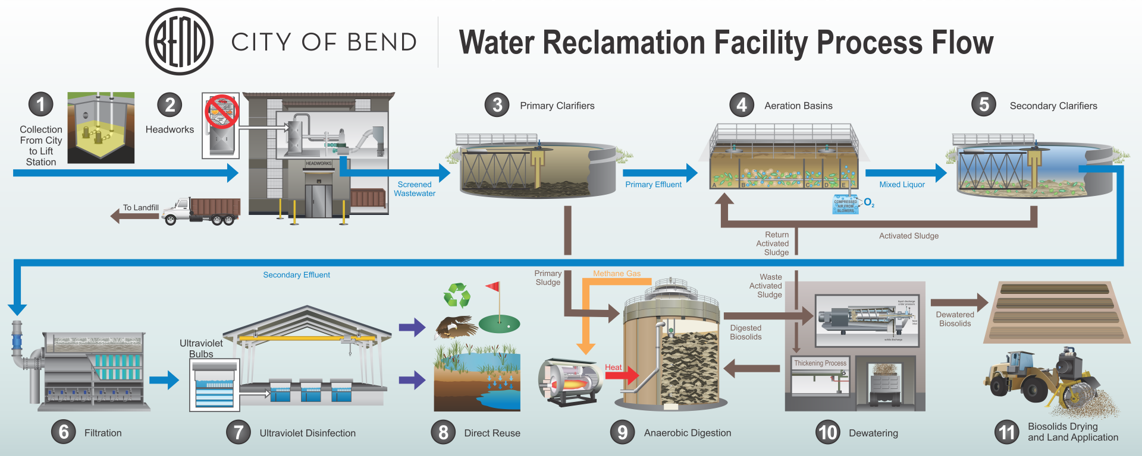
The Process…

Slide 13
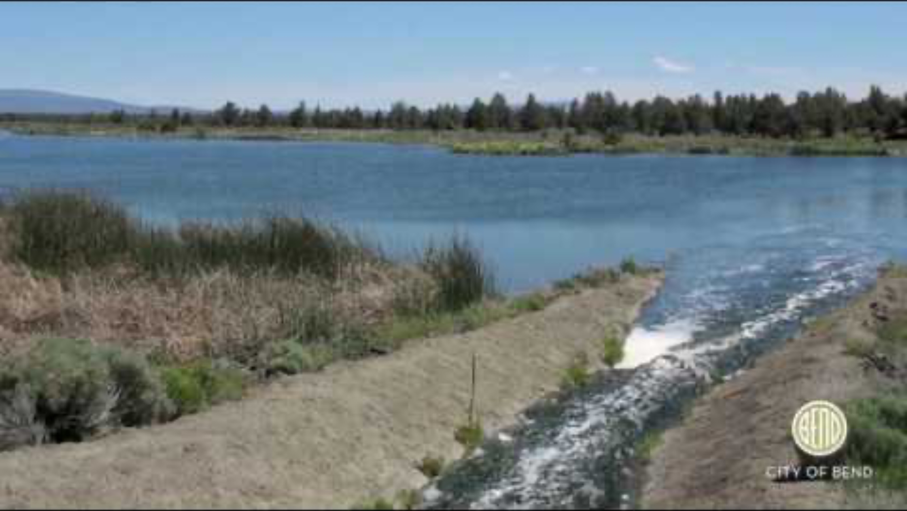
Tour the WRF!

Slide 14
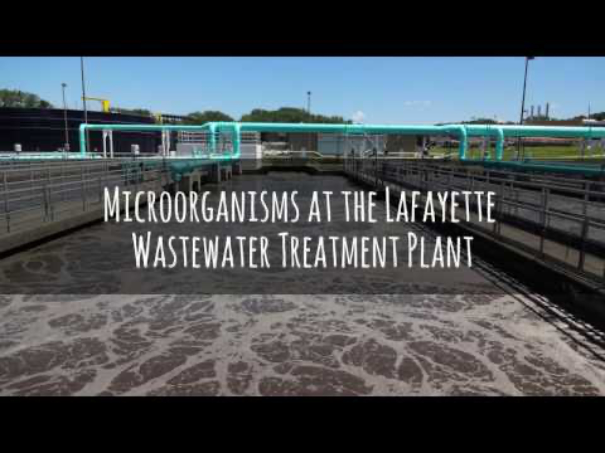
Who cleans the water?
Microorganisms!

Slide 15
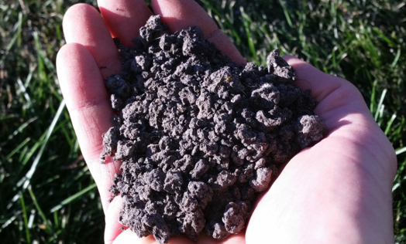
Byproducts of the WRF: Biosolids

Slide 16
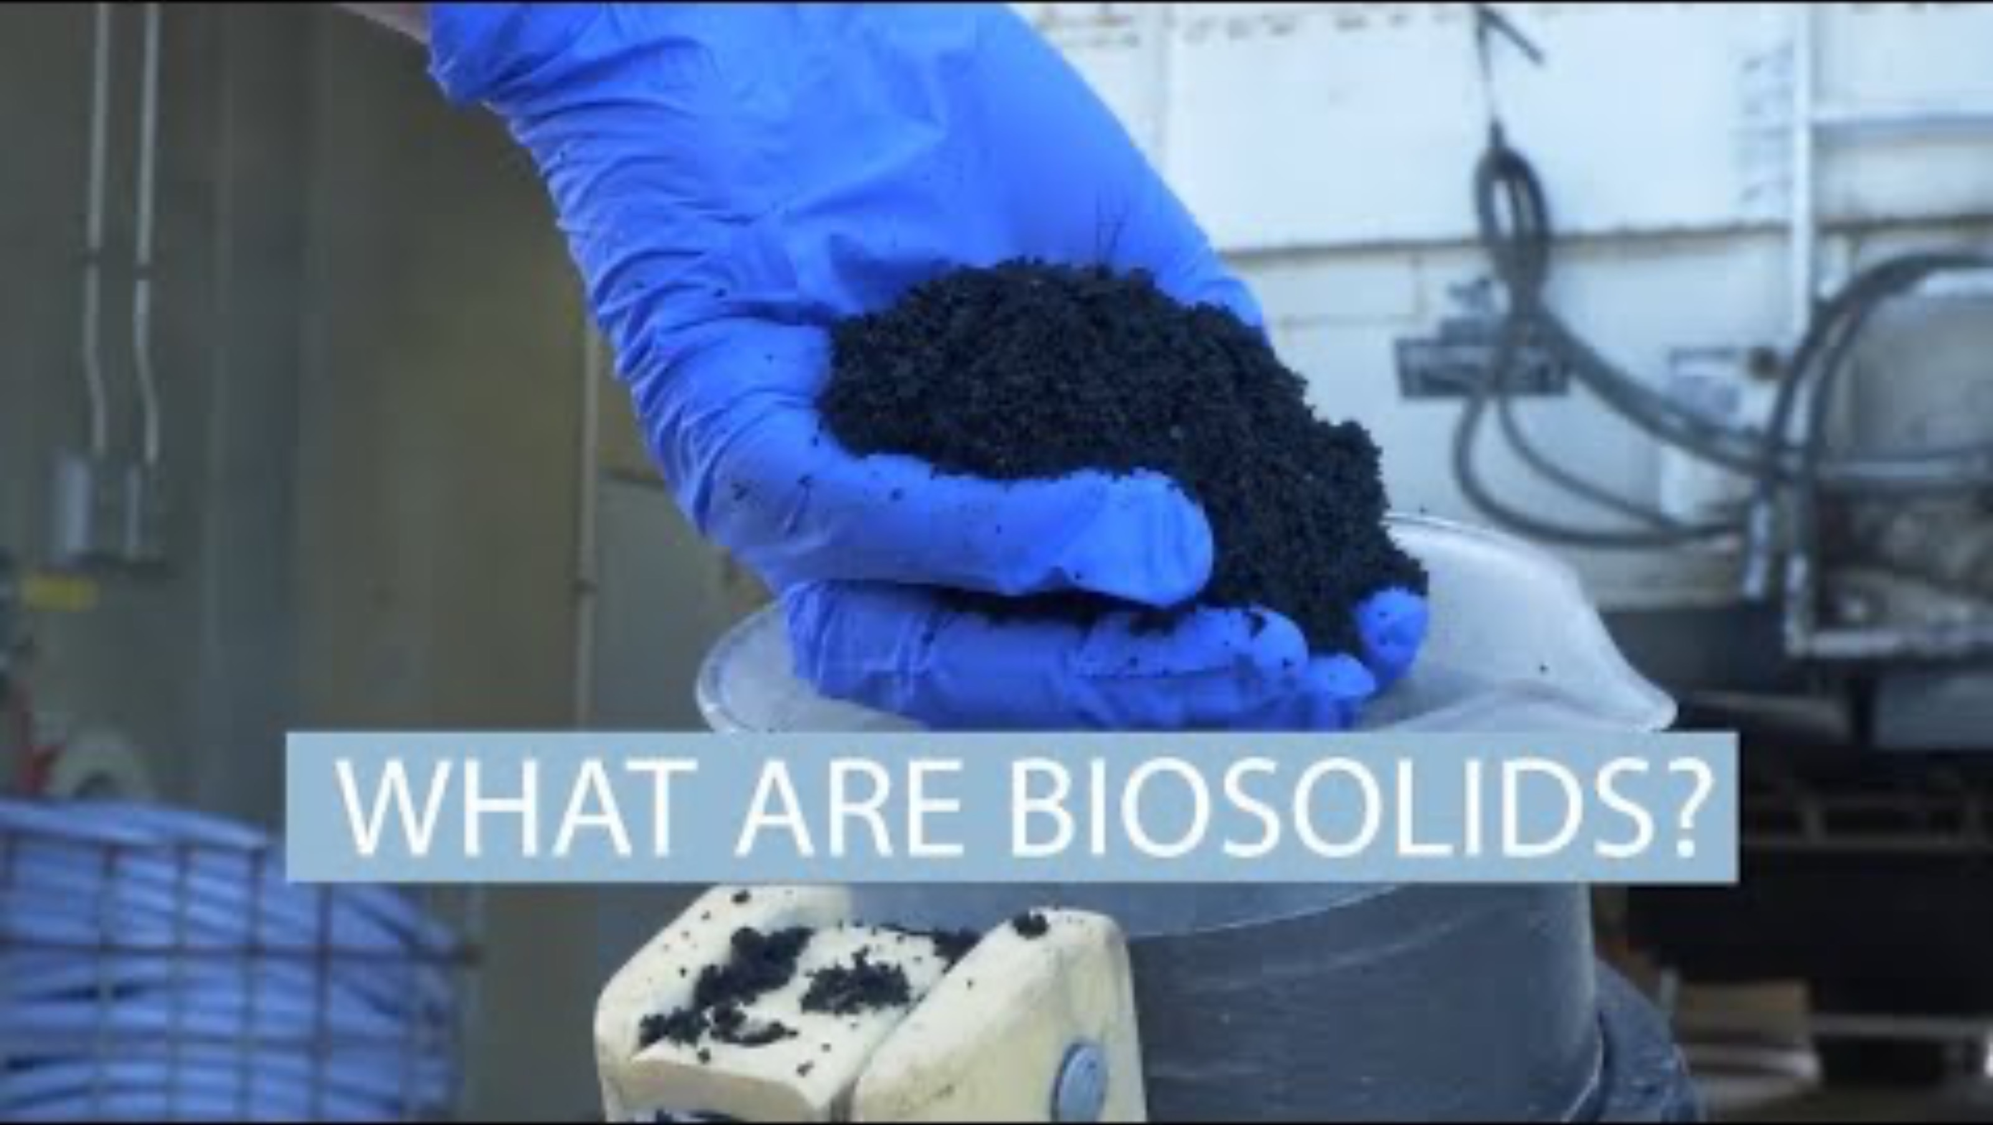
Byproducts of the WRF: Biosolids

Slide 17
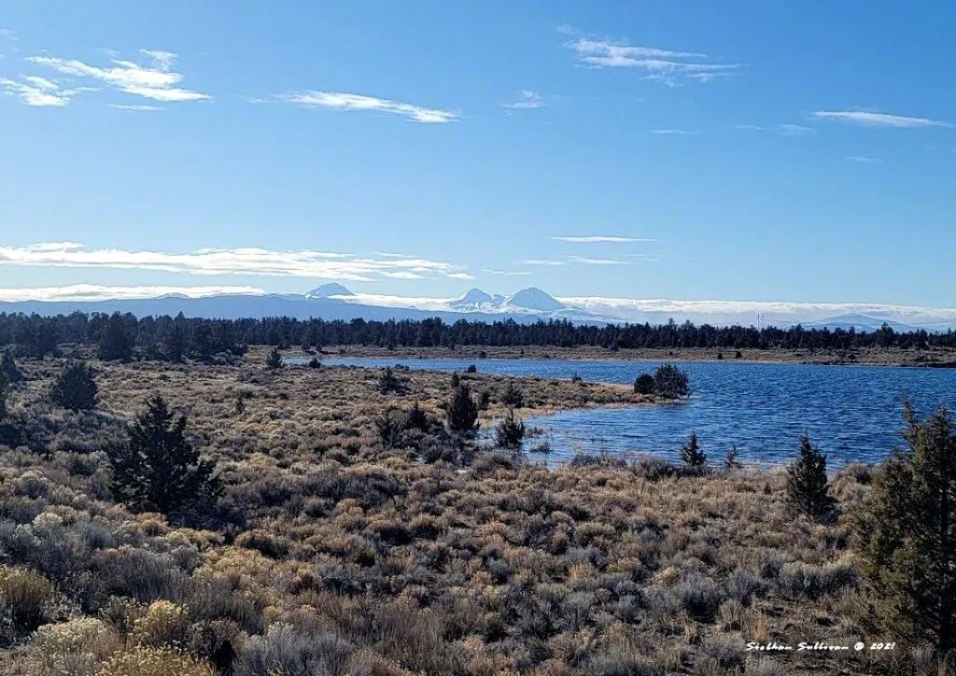
Byproducts of the WRF: Reclaimed Water

Slide 18


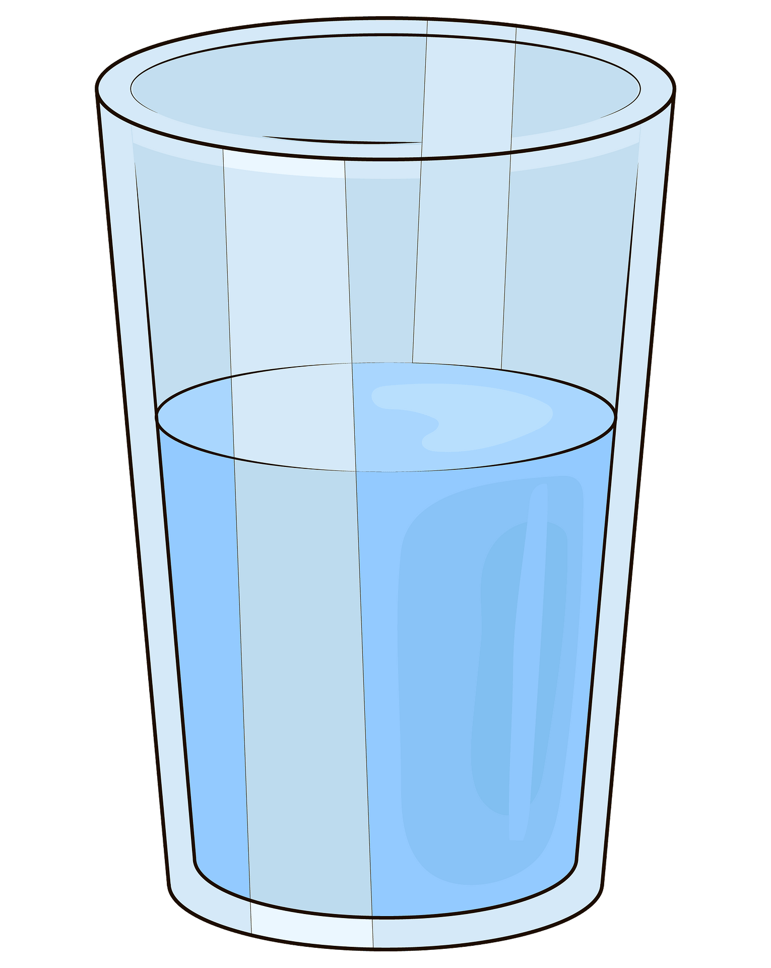



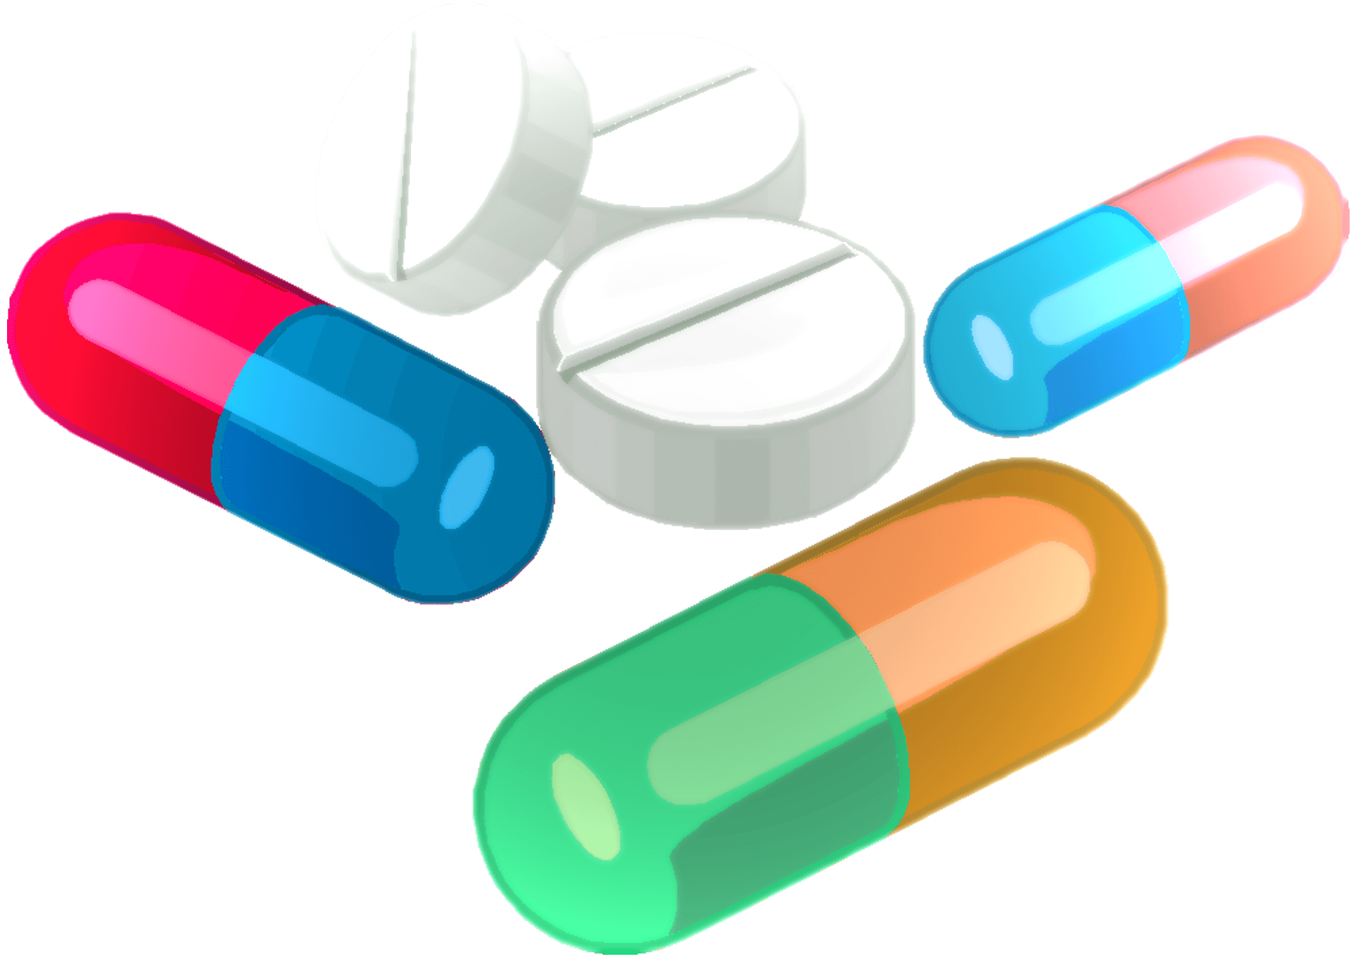
Wastewater Experiment

Slide 19
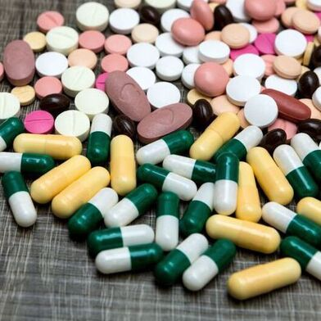
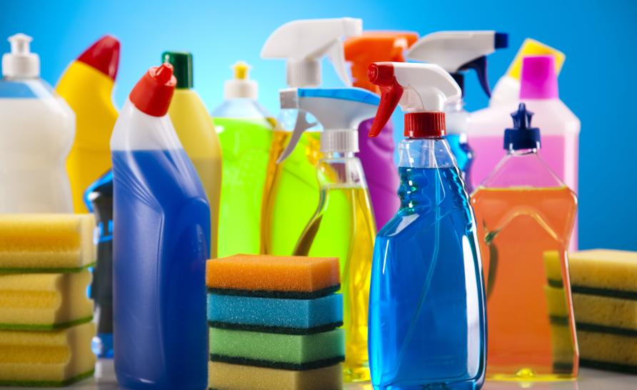

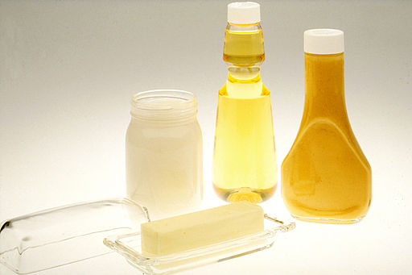
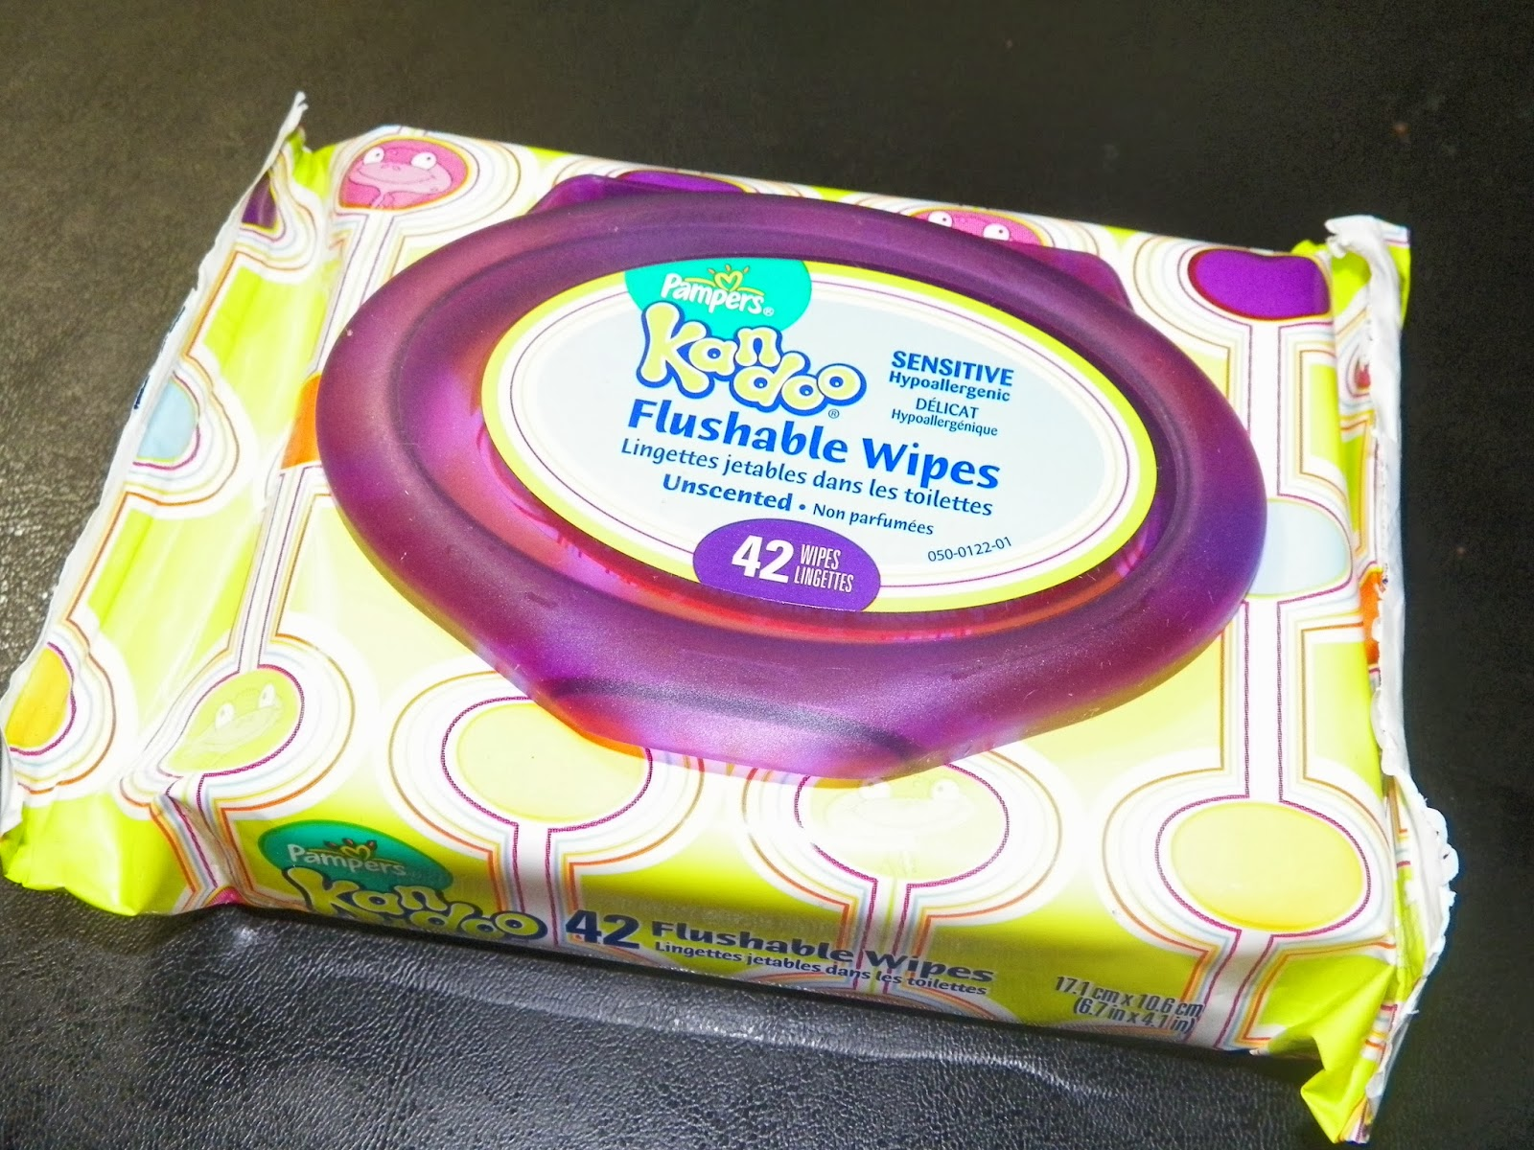
What might happen if we put these materials down the drain?

Slide 20
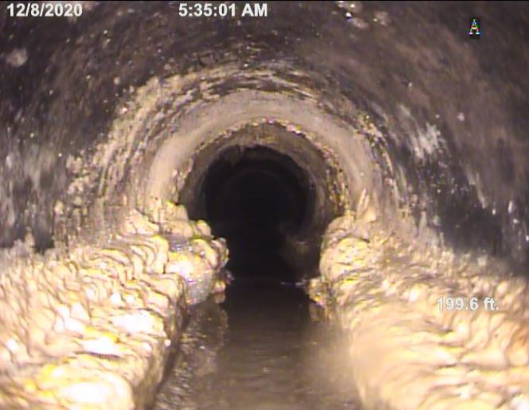
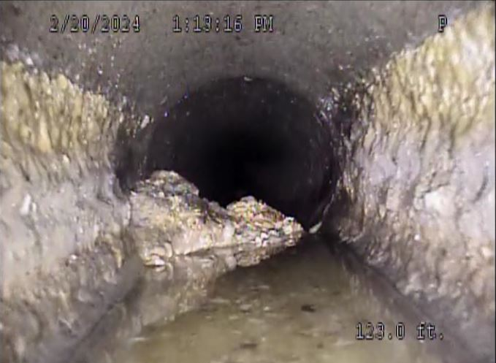
What does a clogged drain look like?
What impacts does it have for water reclamation?

Slide 21
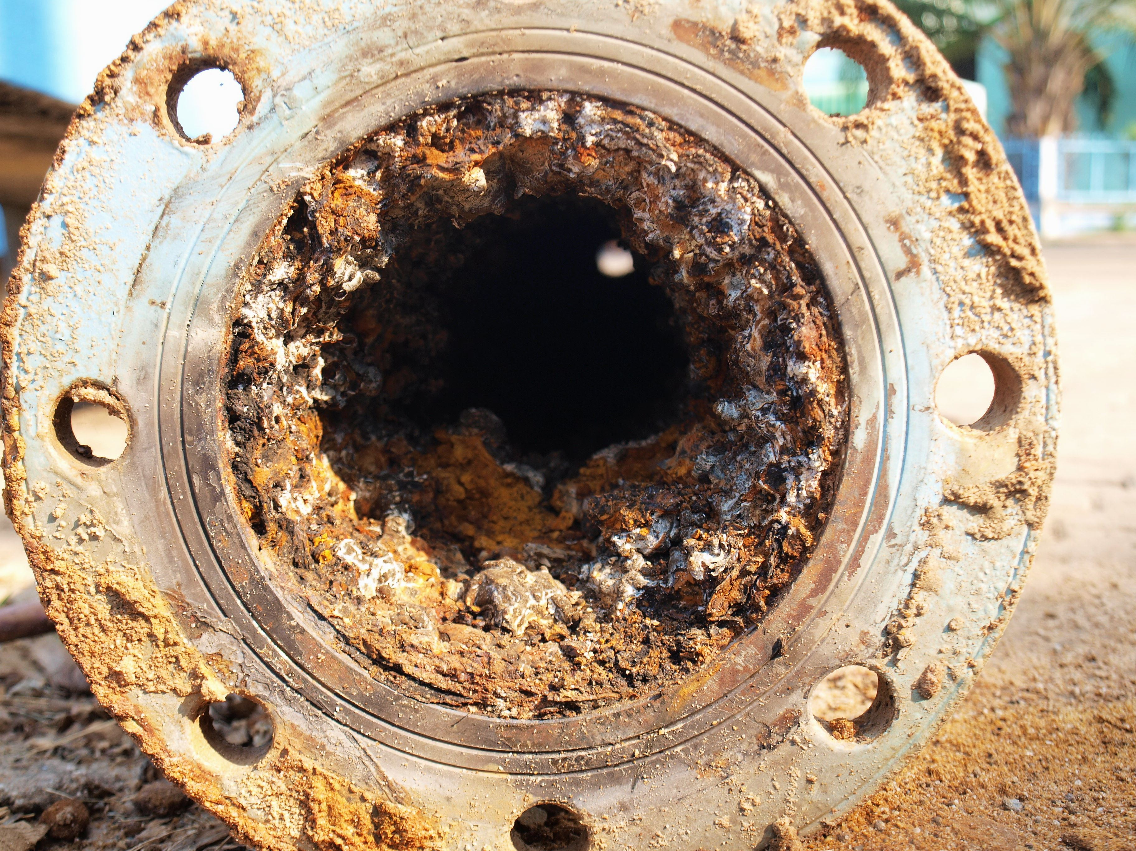
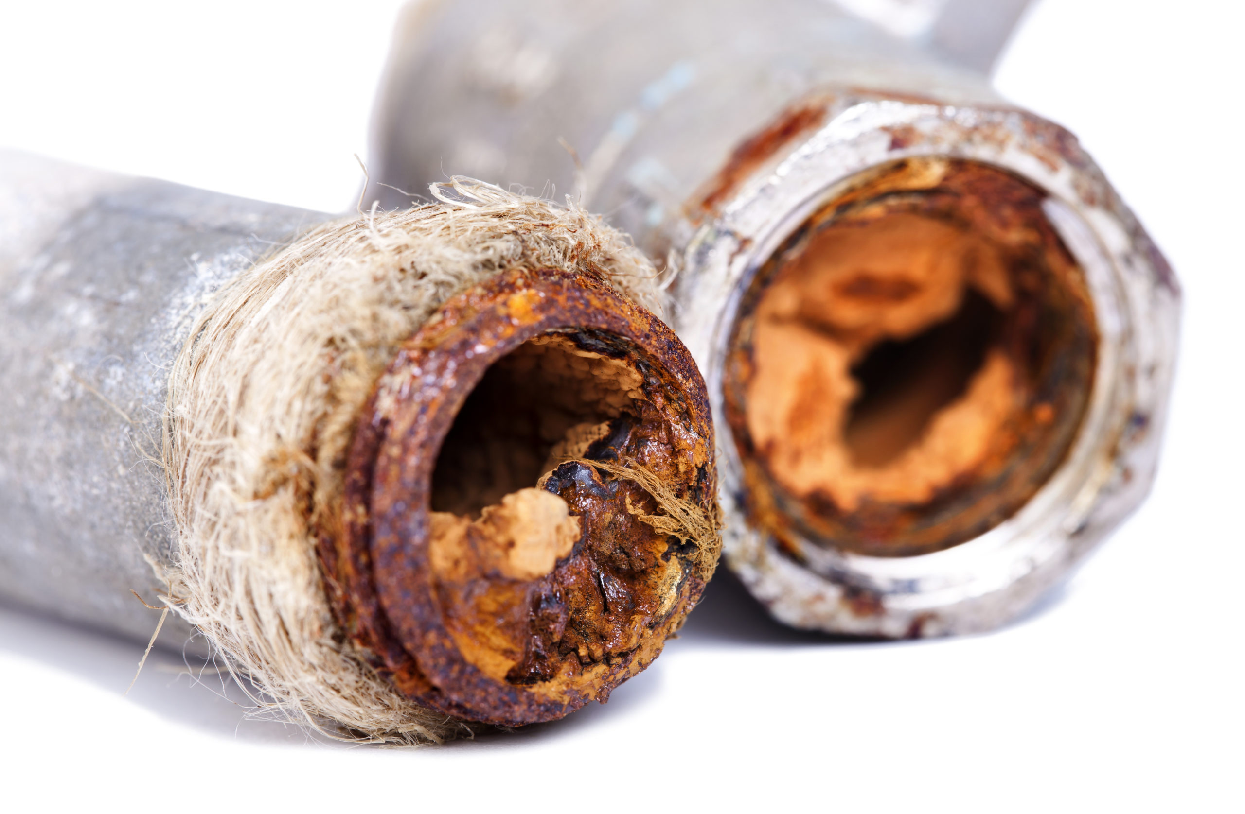
What does a corroded drainpipe look like?

Slide 22
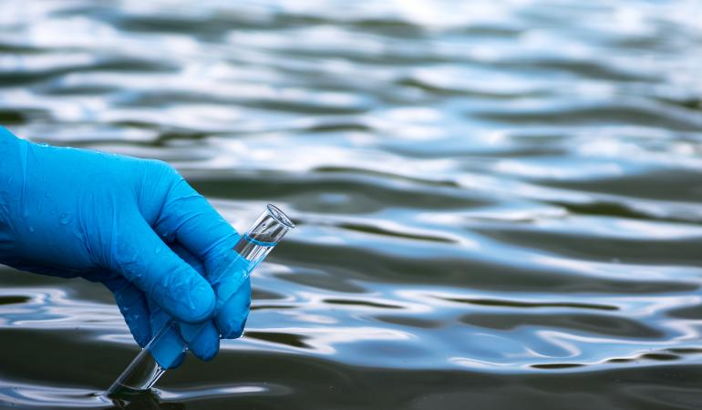
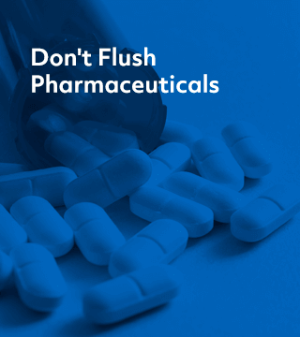
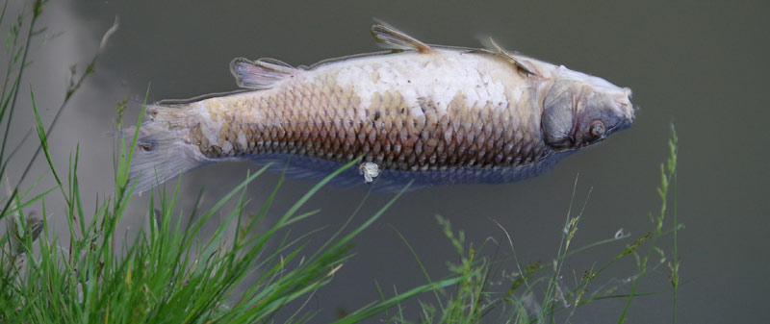

Slide 23
Essential Questions
What is wastewater?
How can our daily choices affect wastewater quality and treatment?
How can responsible wastewater management help protect our water resources?

Slide 24
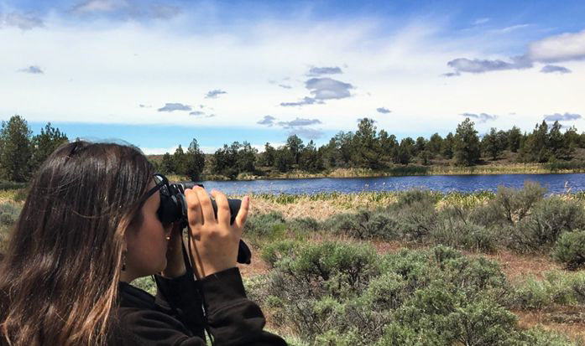
Next Lesson:
Water Reclamation Facility Tour!

Slide 25
WRF Expectations
Closed-toe shoes
Dress with layers
Keep backpacks on the bus
Stick together with the group
Be respectful of the space
Hands to yourself
Be a role model for future trips!

