Slide 1
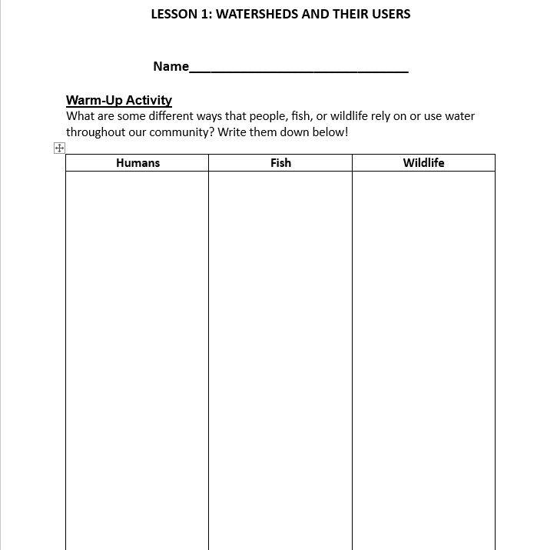

Warm Up
What are some different ways that people, fish, and wildlife rely on or use water throughout our community? Write them down in your journal!
Example: Drinking

Slide 2

One Water Program
Upper Deschutes Watershed Council

Slide 3
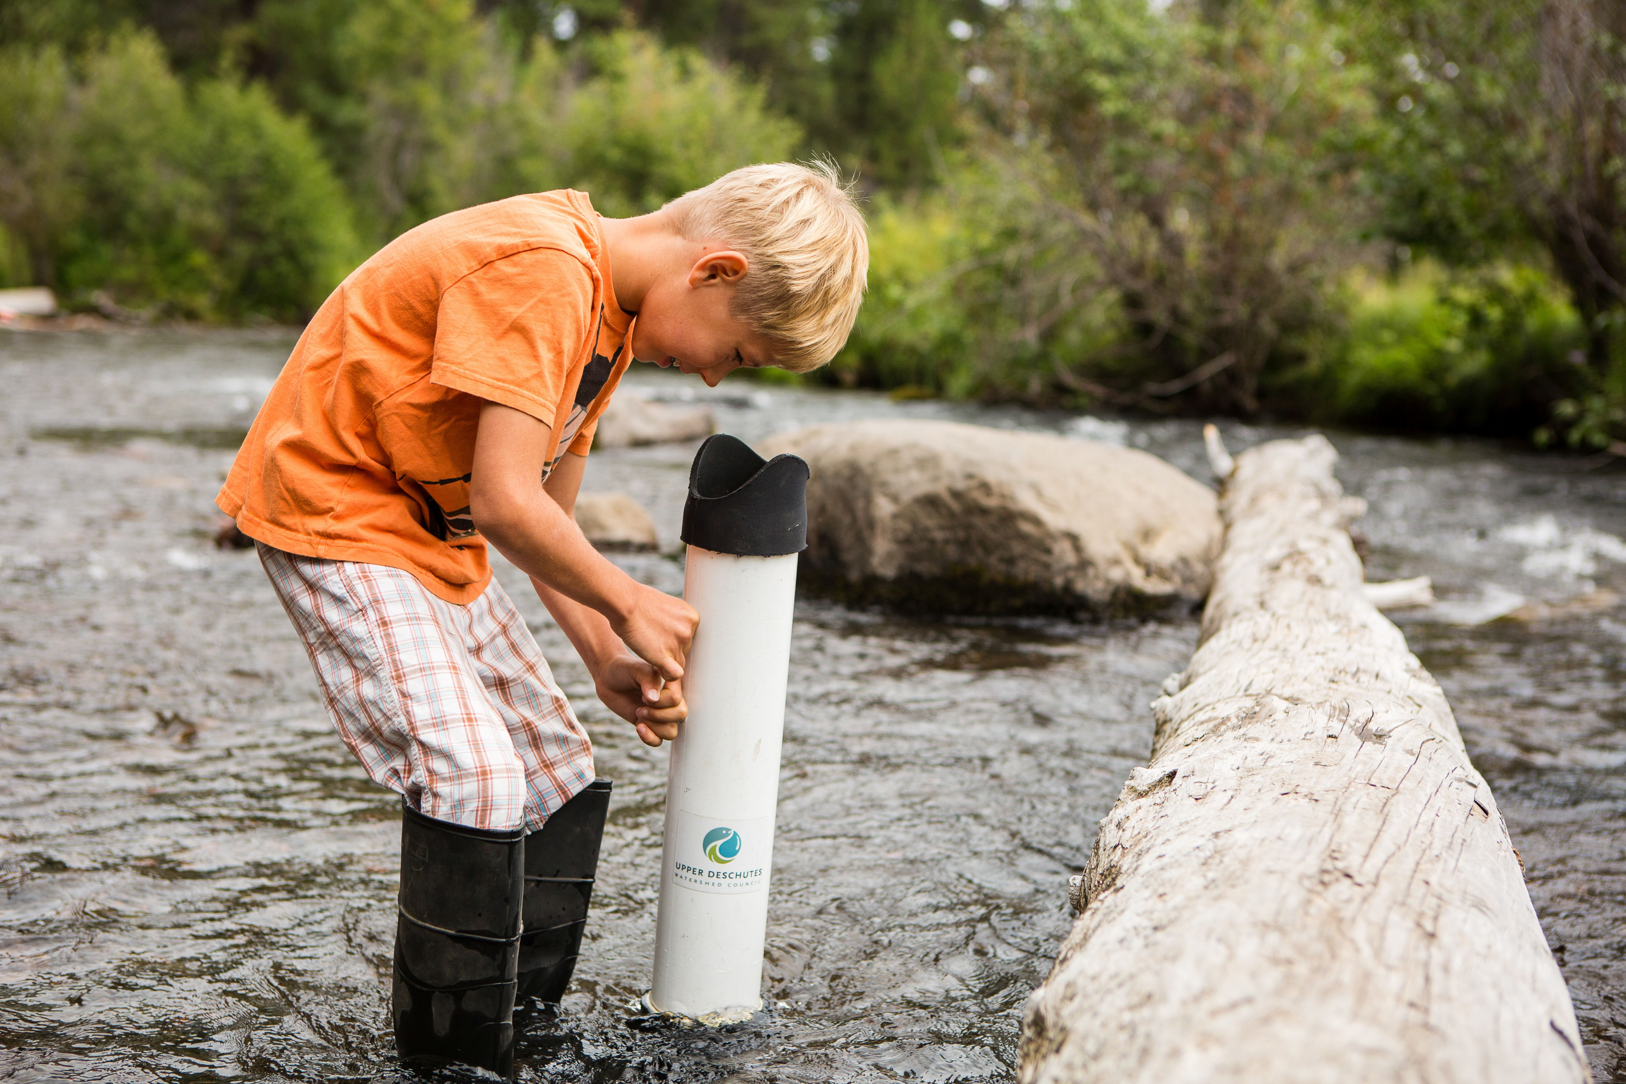
Who is the Upper Deschutes Watershed Council?
The UDWC works to protect and restore the two-million-acre Upper Deschutes watershed through collaborative projects in habitat restoration, watershed education, and long-term monitoring.

Slide 4
Who is the City of Bend?
The “City” is a local government agency that provides services within the city limits of Bend like the ones to the right!
Fire and Rescue | Police | Community Development
Engineering and Infrastructure Planning | Municipal Court | Informational Technology
Finance | Transportation and Mobility | Utilities

Slide 5
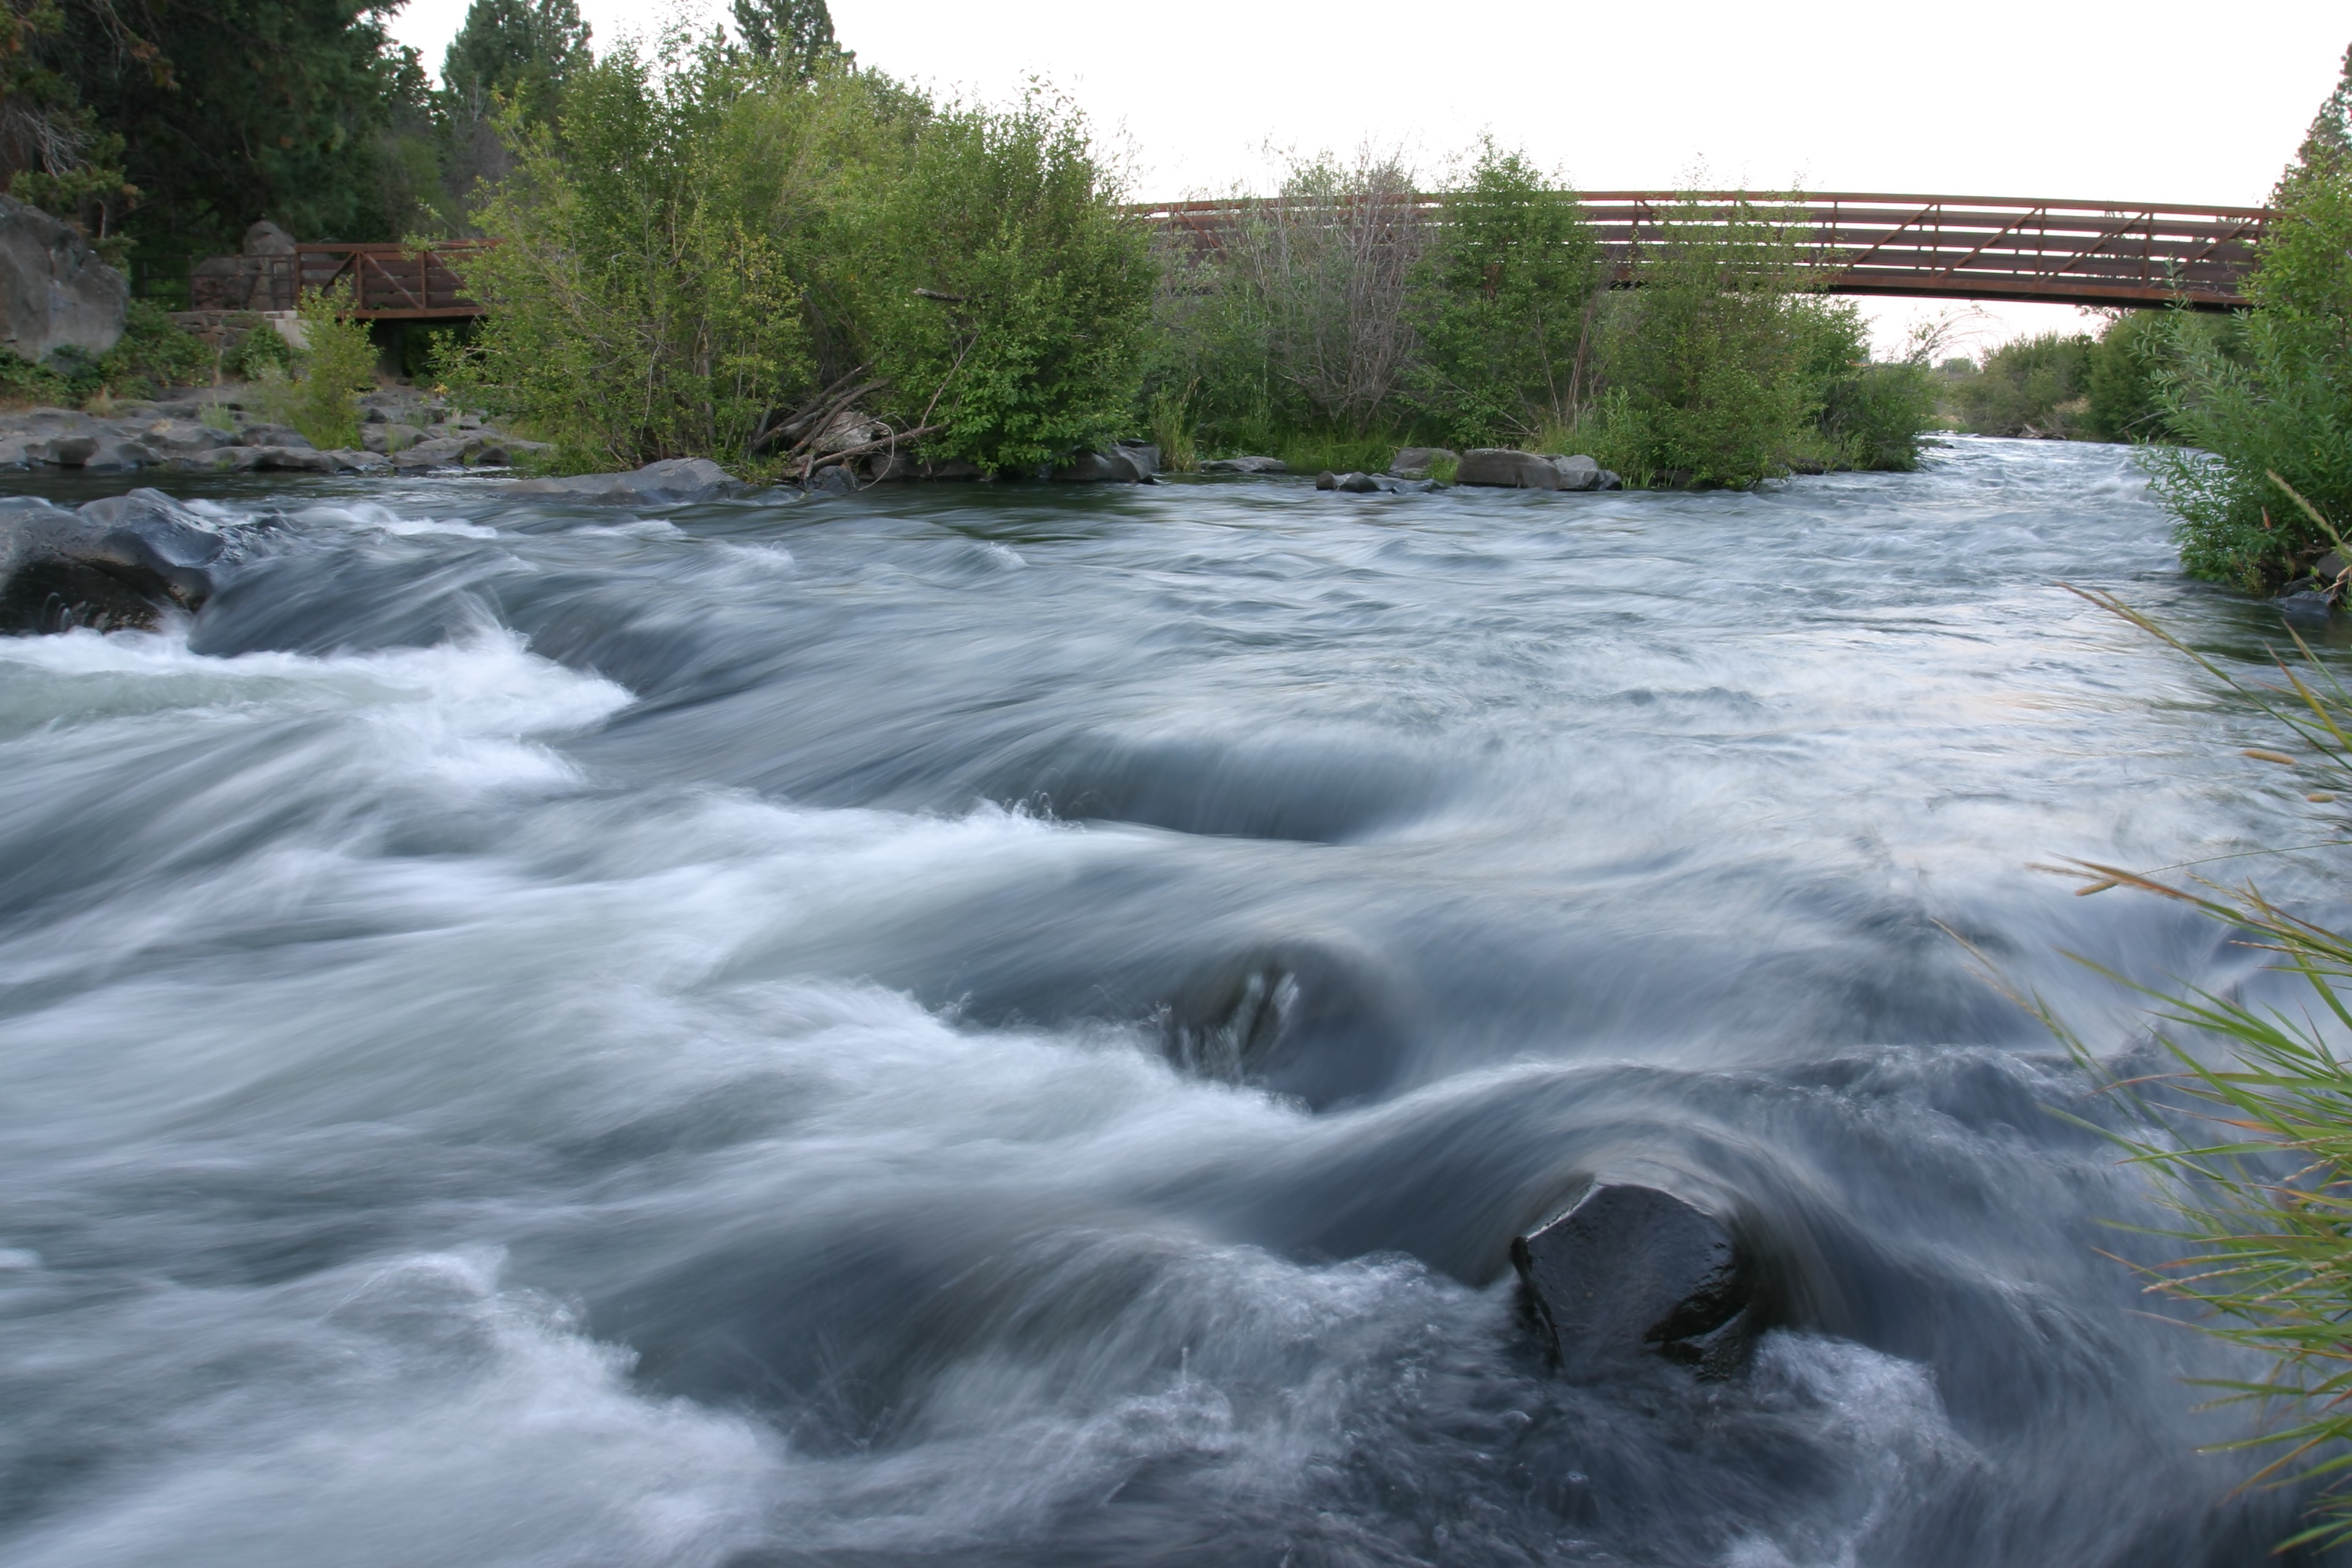
What is the One Water program?
In this program, you will find out…
Where our water comes from
Who uses it
Where it goes after it is used
How it is treated
How we can conserve and protect this vital resource

Slide 6
Today’s essential questions:
How are humans, fish, and wildlife dependent on water?
How can the way we use water have an impact (positive or negative) on our watershed and our community?
What can humans do to reduce their negative impacts on our watershed?

Slide 7
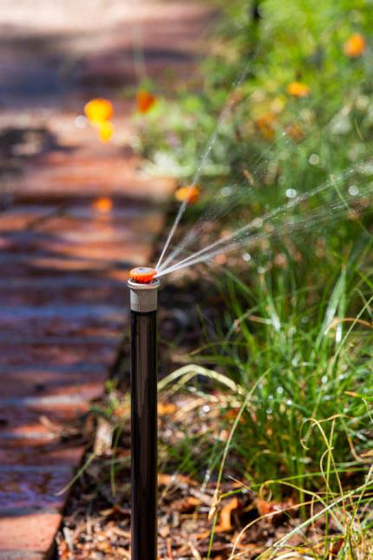
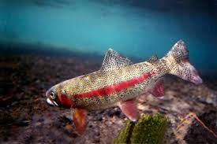
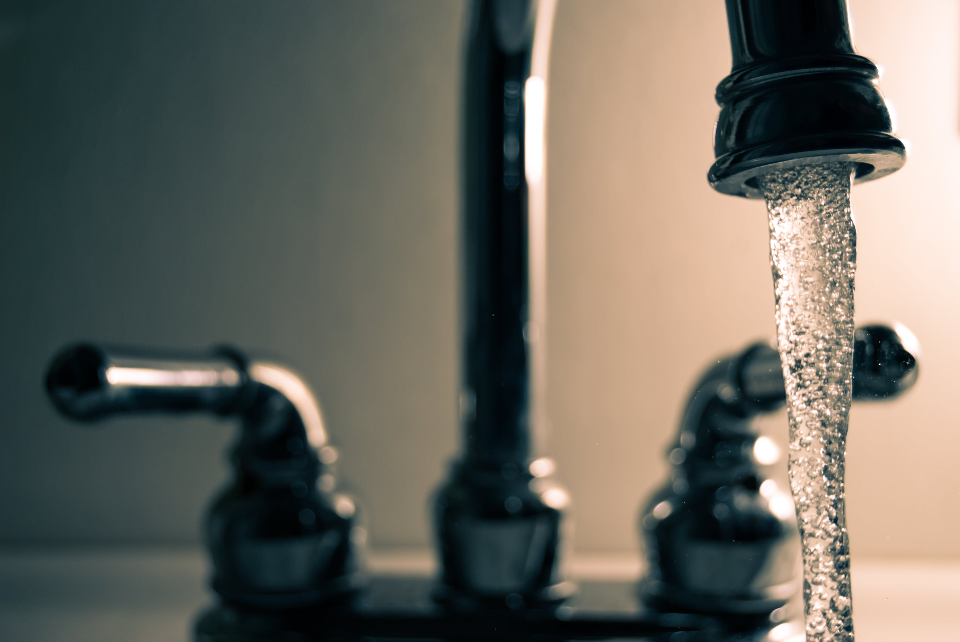
What are some different ways that people, fish, and wildlife rely on or use water throughout our community?

Slide 8
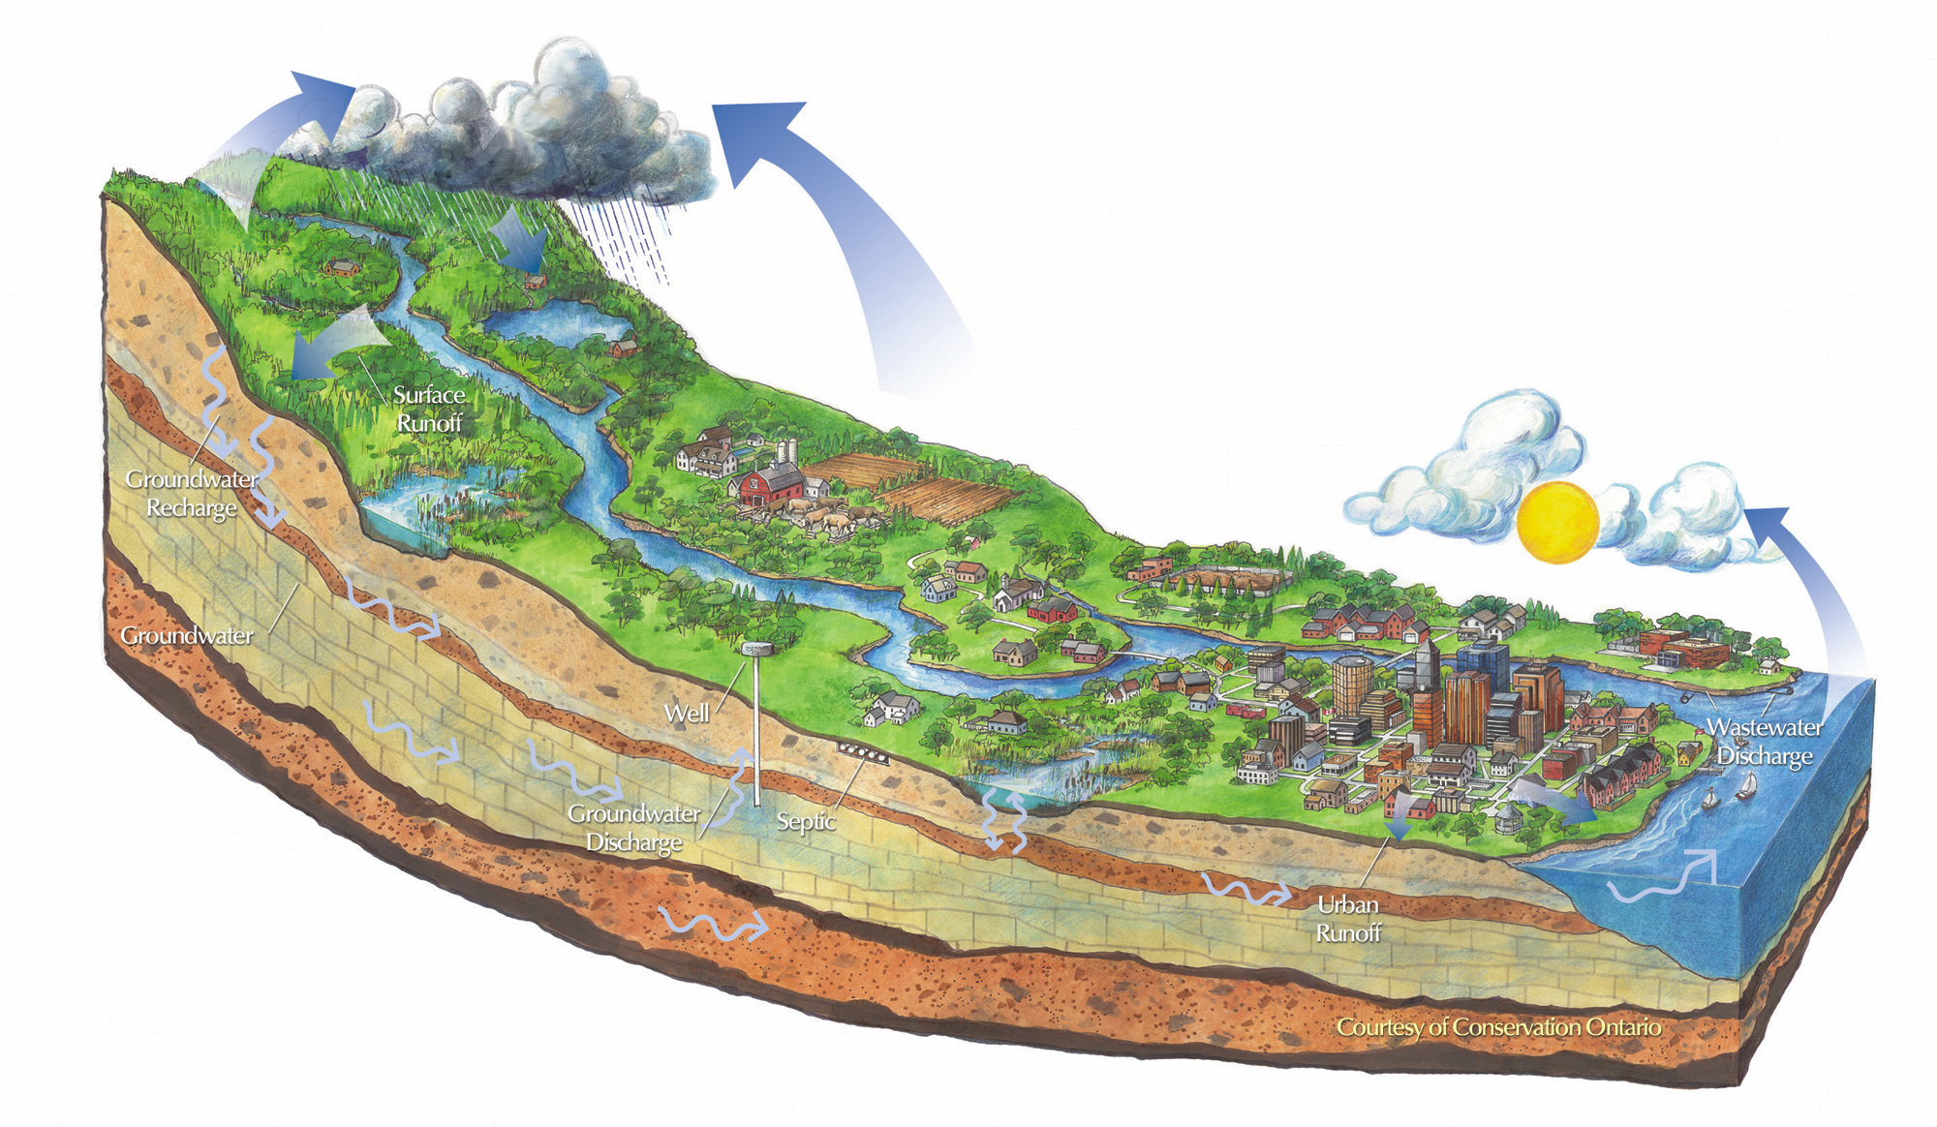
Where and how do we get this water?
From a watershed!

Slide 9
What is a watershed?
An area of land where water flows to a common point.
The entire area, from ridgetop to ridgetop which drains into a river or stream

Slide 10
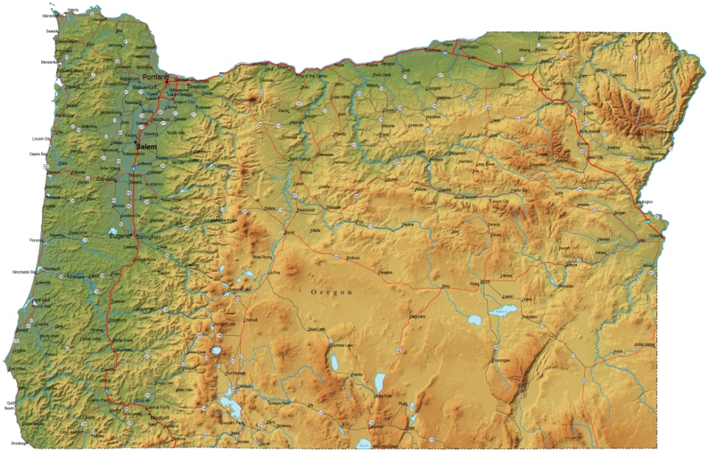
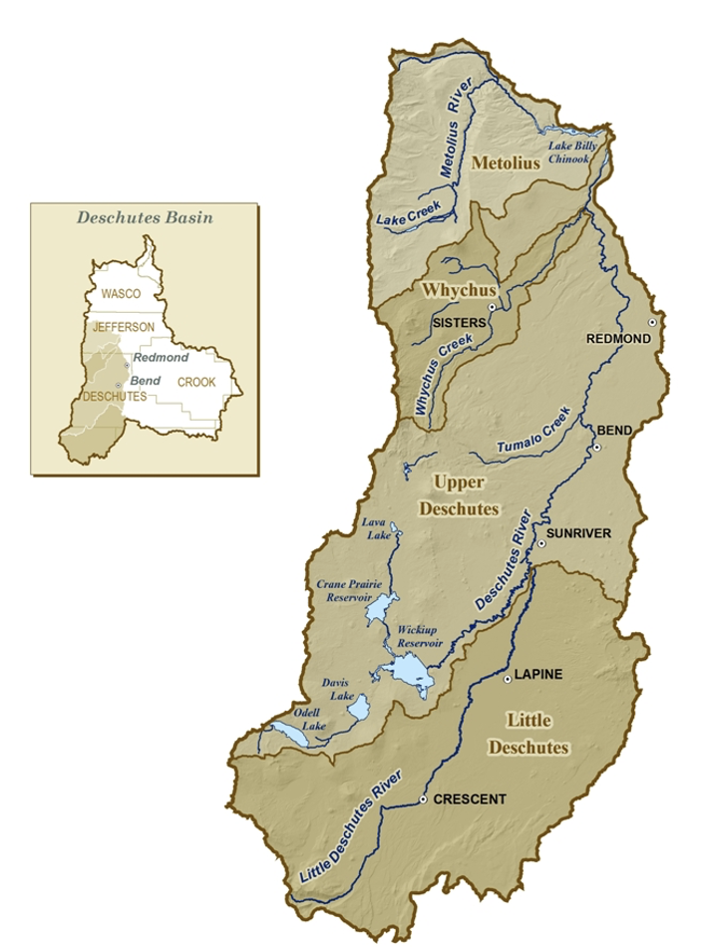
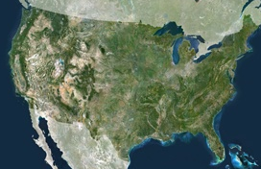
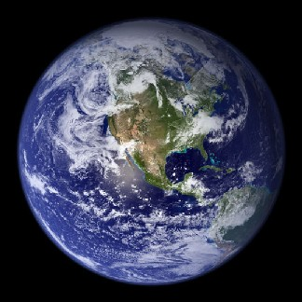
What subbasin do we live in?
The Upper Deschutes River subbasin!

Slide 11
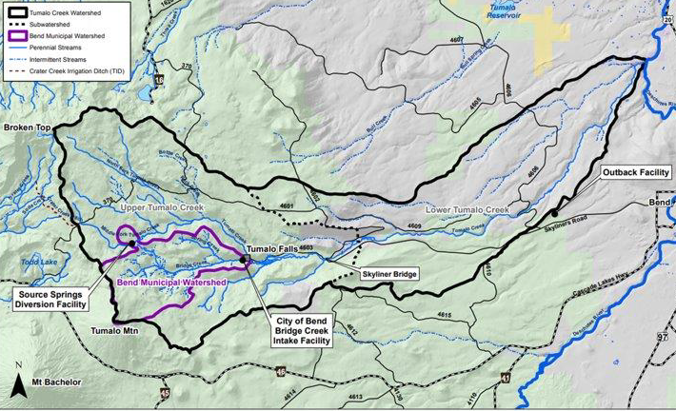
Where do we get our drinking water?
The Bend Municipal Watershed

Slide 12
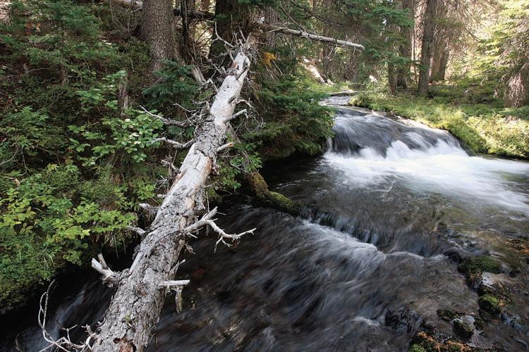
Bend has two main sources of water for human use:
Surface Water
Groundwater

Slide 13
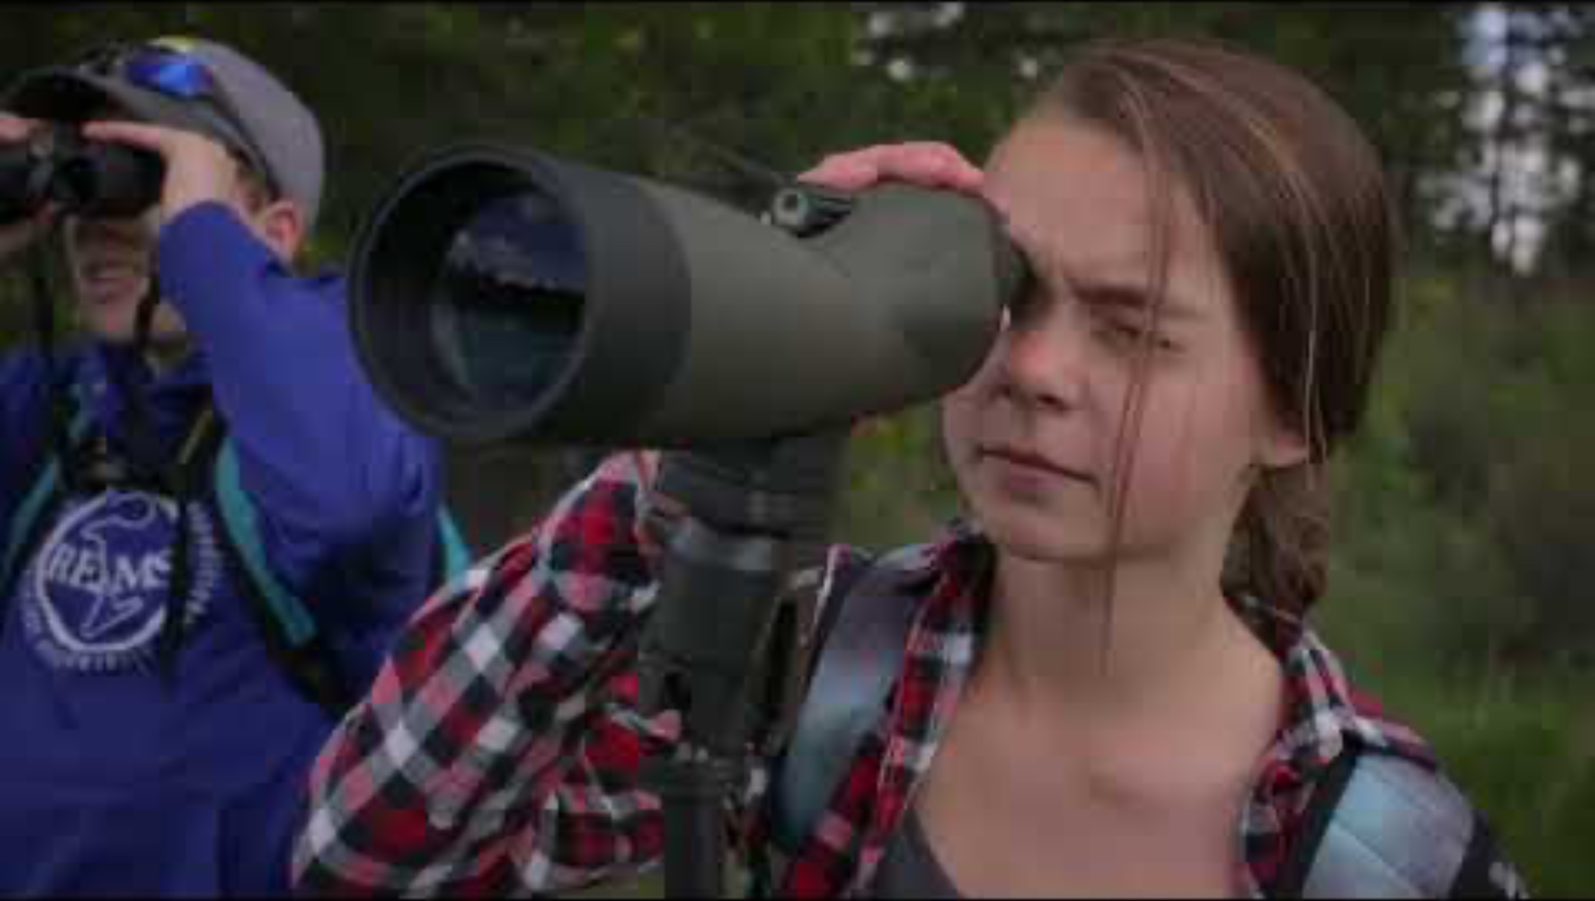

Slide 14
Reflection Activity: Maitre d’!
Walk around, listen for “table for ____”, and then form your group!
Listen to the question and talk for 1-2 minutes. Make sure everyone in the group shares.
Stop when you hear the bell.
Repeat. Try to work with different people each time!

Slide 15
Reflection Question #1:
Who do you think needs water the most in the video? Our city, fish, farmers...?
Why do you think they need it the most?

Slide 16
Reflection Question #2:
Who do you think might have the biggest negative impact on our water in the video?
Why did you choose that watershed user?

Slide 17
Reflection Question #3:
Do you think that watershed users can have less of an impact on our water and the watershed?
If so, how?

Slide 18
Reflection Question #4:
Which watershed user do you identify with the most? Farmer, city user, recreator...?
Why did you select that user? Share some specific reasons!

Slide 19
Reflection Question #5:
What was something surprising you learned from this video about water use?
Why was it surprising to you?

Slide 20
Today’s essential questions:
How are humans, fish, and wildlife dependent on water?
How can the way we use water have an impact (positive or negative) on our watershed and our community?
What can humans do to reduce their negative impacts on our watershed?

Slide 21
Next Lesson: The Path of Water!

Slide 22
