Slide 1
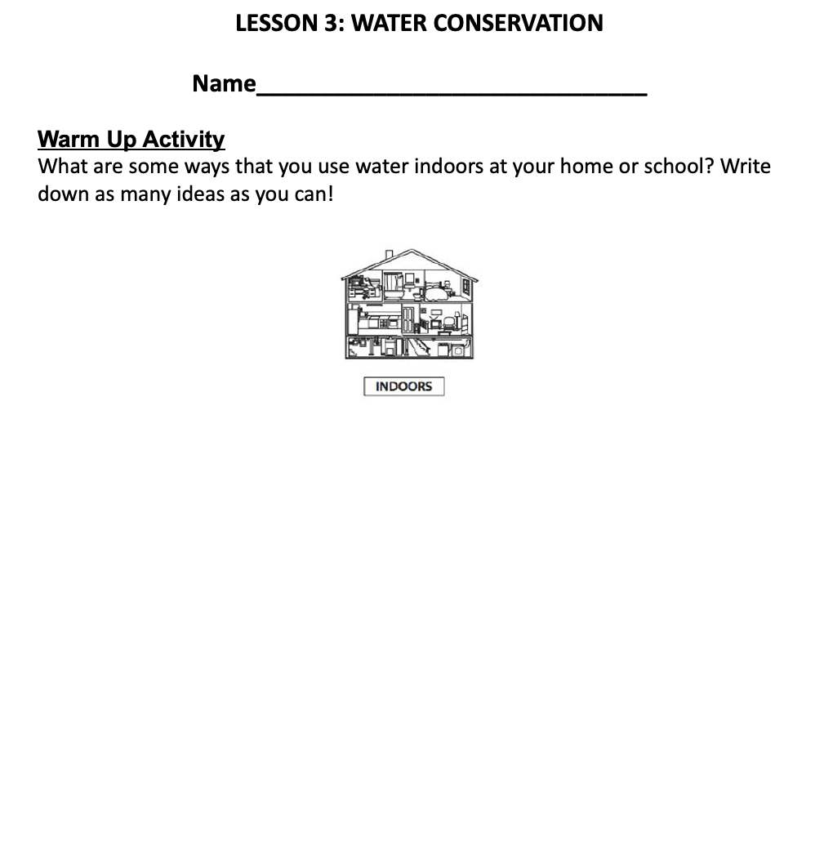

Warm Up
What are some ways that you use water indoors at your home or school?
Write down as many ideas as you can in your journal!

Slide 2

One Water Program
Upper Deschutes Watershed Council

Slide 3
Essential Questions
Why is water considered a limited resource, even though it covers most of Earth?
How is our water use indoors connected to our local watershed?
What choices can we make to measure and reduce our indoor water use and protect our watershed?

Slide 4


True or False Review Game
Let’s see what you remember!
Dance move in your desk space if it’s true
Finger waggle if it’s false

Slide 5
True or False?
The Deschutes River is where Bend gets its municipal drinking water.
A watershed is an area of land that channels rainfall, snowmelt, and runoff into a body of water.
The watershed we get our drinking water from is called the Bend Municipal Watershed
The water that goes down our drains goes to the ocean

Slide 6
Think-Pair-Share
What are some ways that you use water indoors at your home or school?
Which ones do you think use the most water? Put a star next to them.

Slide 7
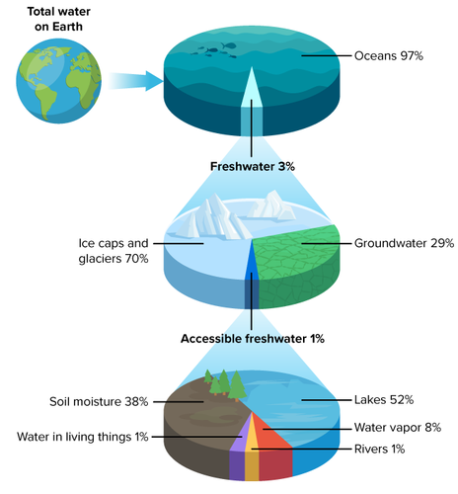
How much water do we have on Earth?
Of all water on Earth:
97% is salt water
3% is freshwater
70% is frozen
30% is non-frozen
29% is groundwater
1% is accessible

Slide 8
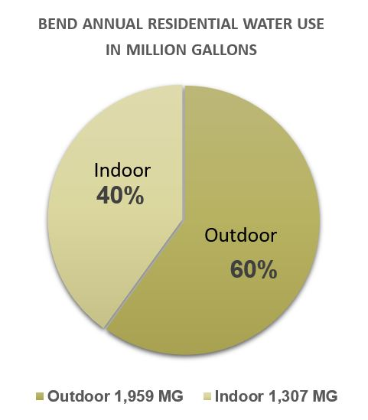
How is water used in our municipality?
___ is indoor use
___ is outdoor use

Slide 9
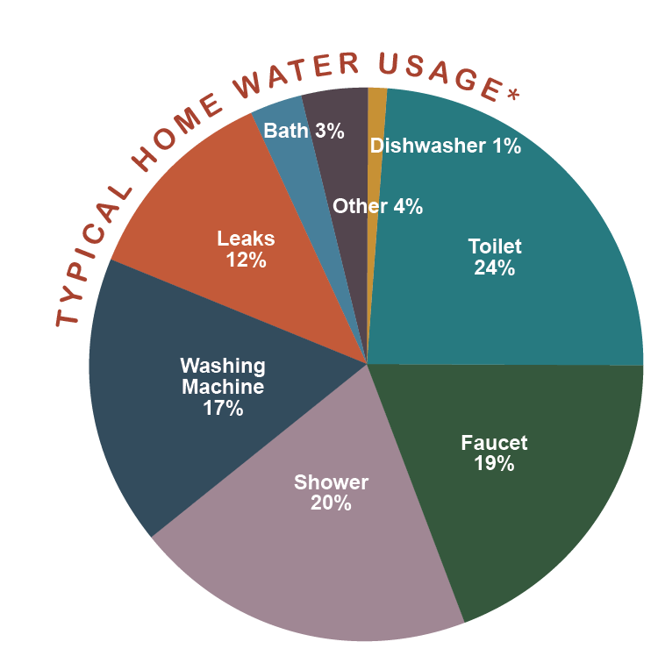
Indoor Water Use
Can you fill out the pie chart in your journal? Try it out!

Slide 10
Indoor Water Use

Slide 11
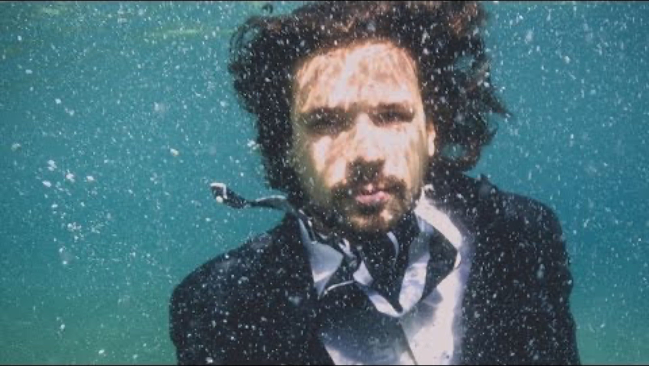
How much water do you use in one day?

Slide 12
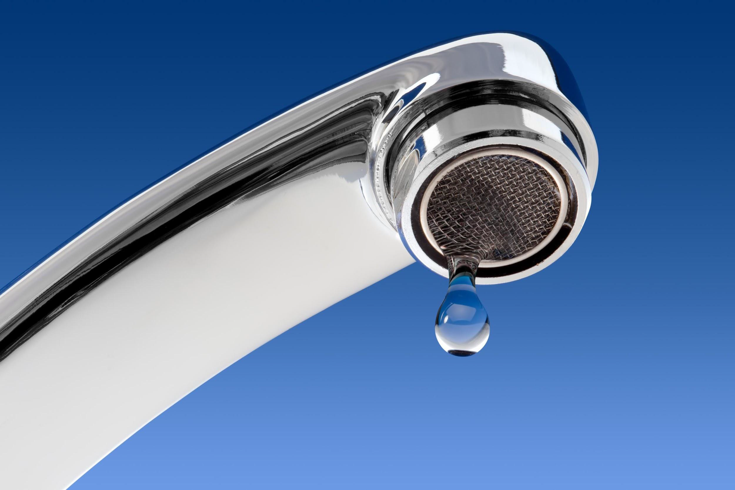
Stand up, hand up, pair up!
What is water conservation?

Slide 13
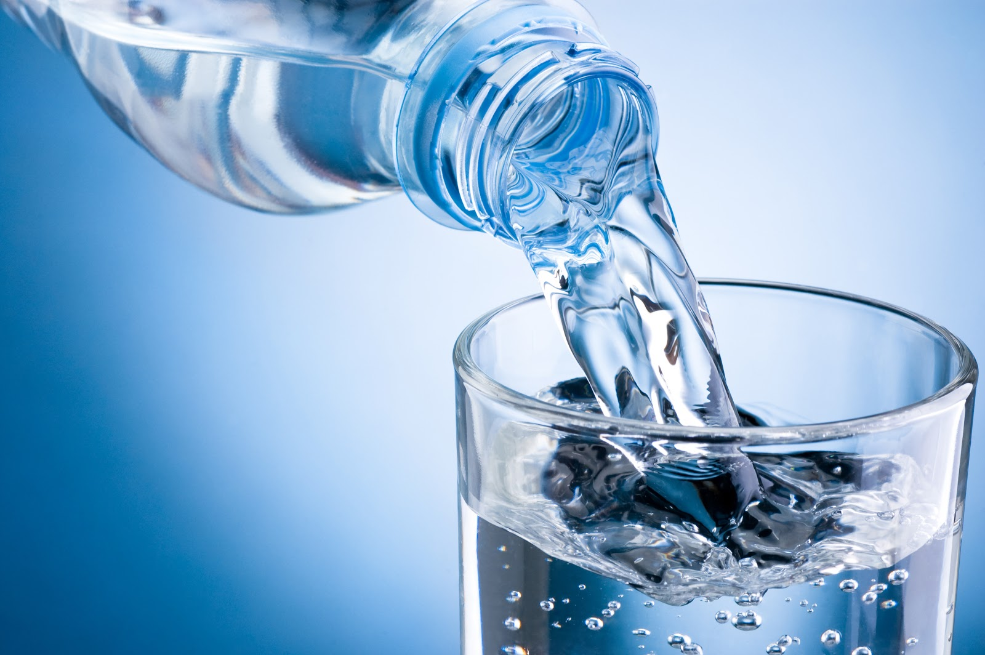
Stand up, hand up, pair up!
Why is water conservation important?

Slide 14

Stand up, hand up, pair up!
Who benefits from water conservation?

Slide 15
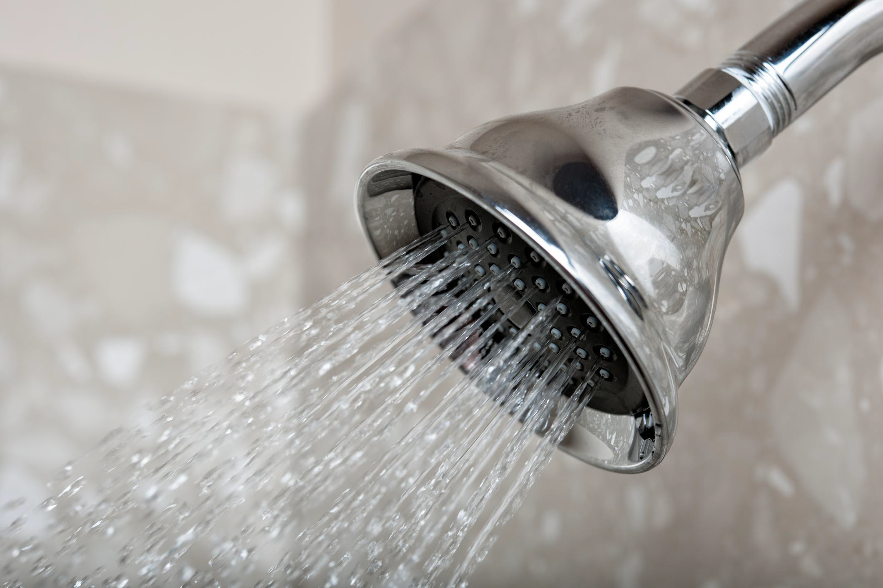
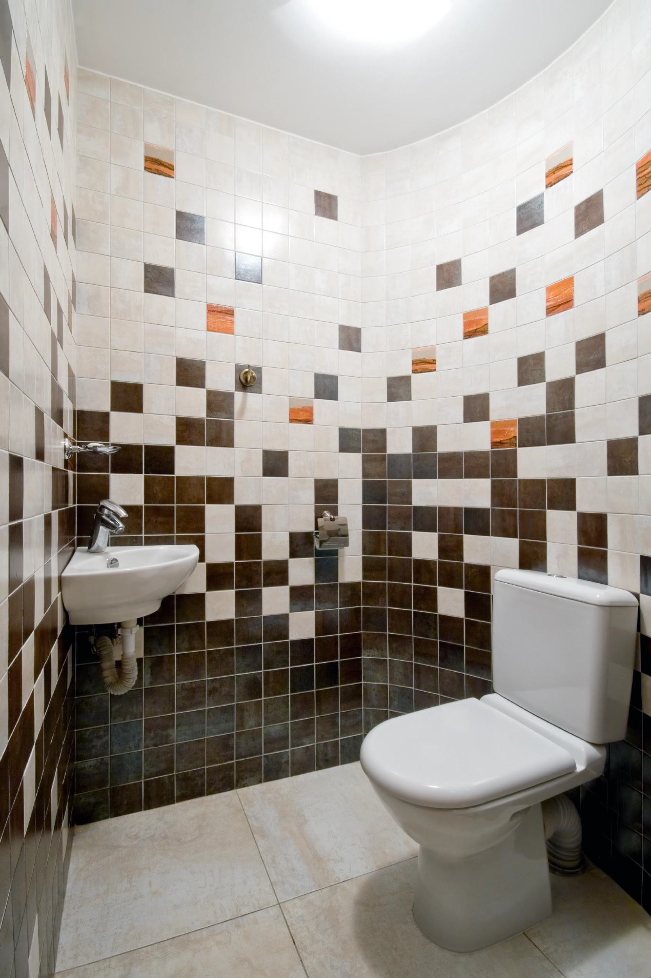
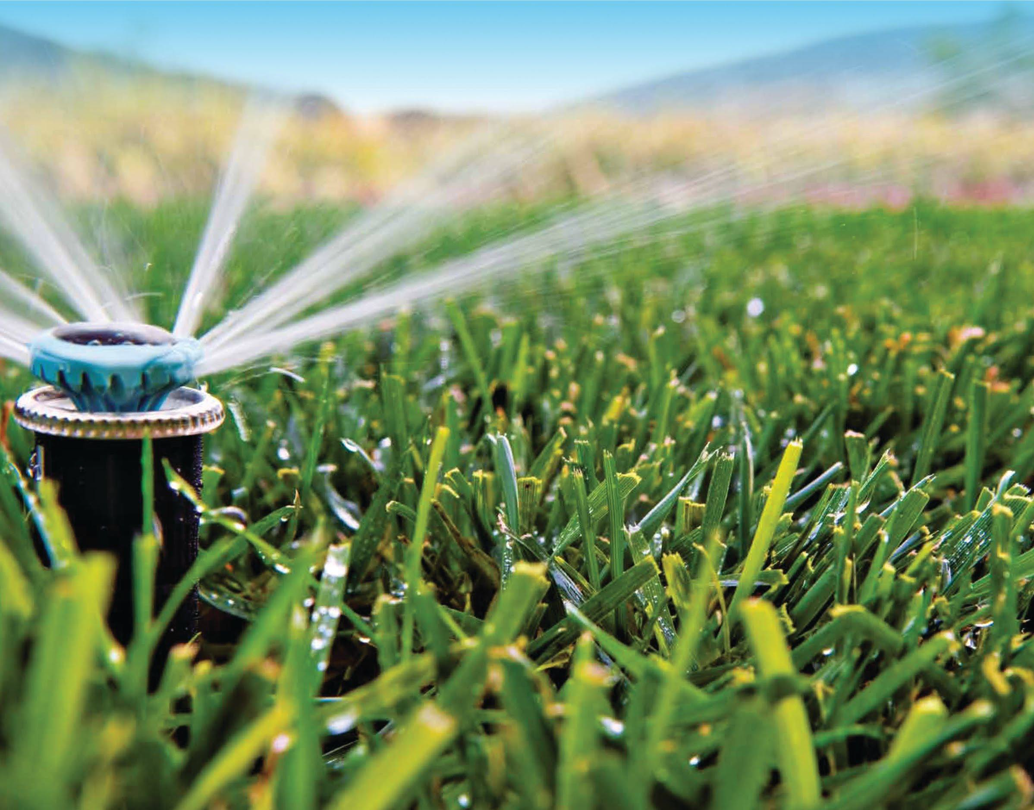
What is water conservation?
The prevention of wasteful use of a resource.

Slide 16
Why is water conservation important?
Freshwater is a vital and limited resource
The City doesn’t take water unless there is a demand for it
Prolongs our drinking water supply
Saves money by reducing energy consumption
Can increase resistance to drought

Slide 17
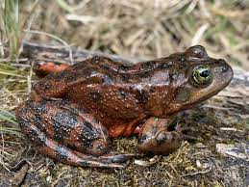
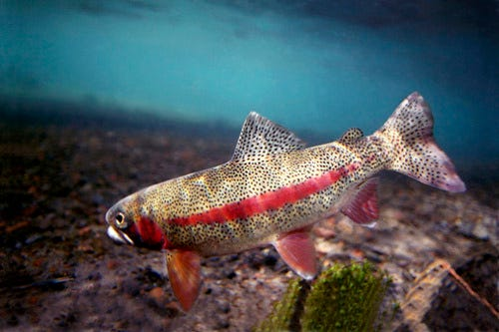
Who benefits from water conservation?
Oregon spotted frog
Endangered species
Redband trout
Threatened species
Without enough water, fish and wildlife can be significantly impacted.

Slide 18
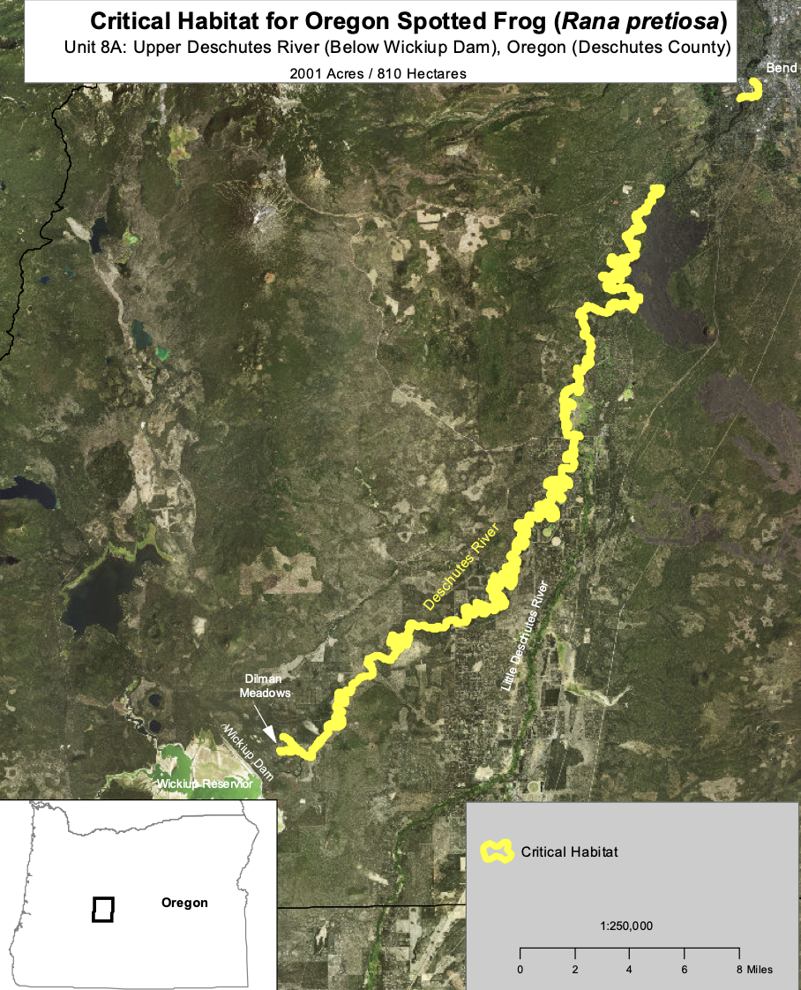
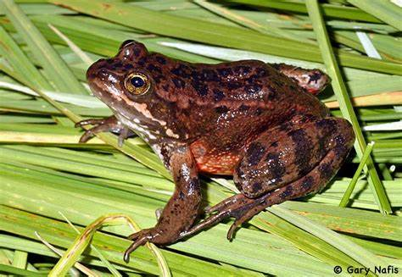

Slide 19
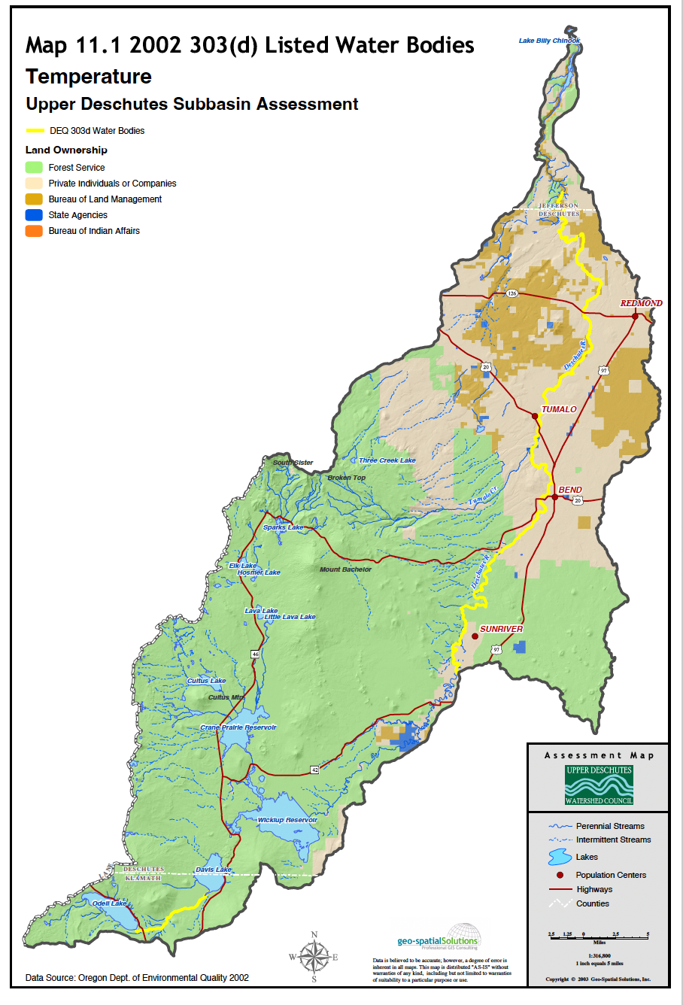

Slide 20
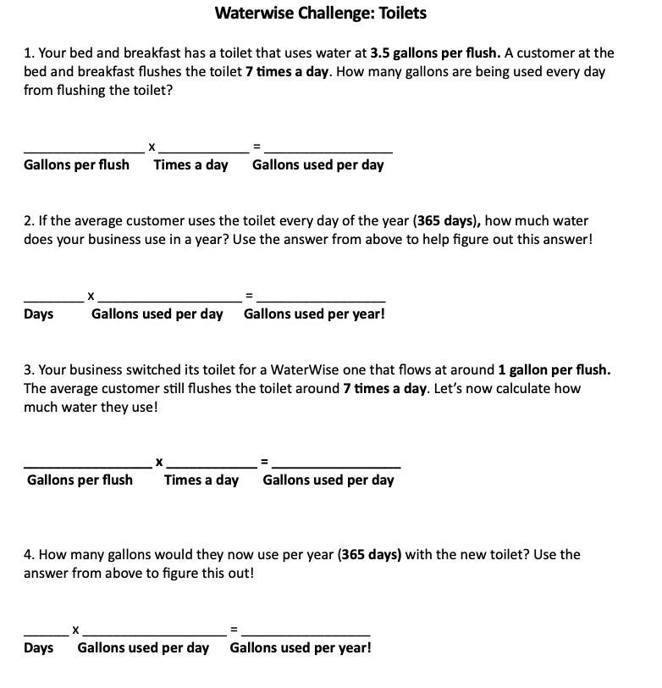
WaterWise Challenge!
Complete as many of the calculations in your journal! You can work with a buddy.

Slide 21
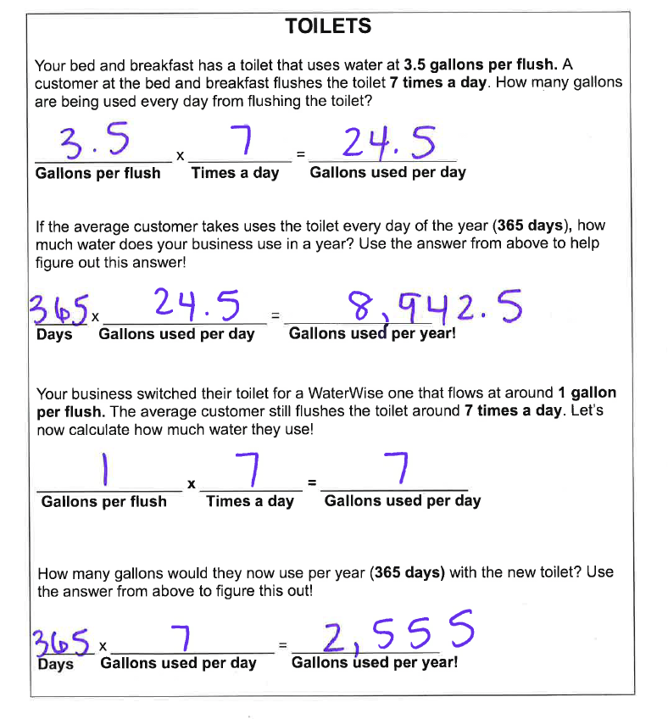
By switching to a WaterWise toilet, you can save around 6,387.5 gallons of water per year!
That’s about 150 bathtubs full!

Slide 22
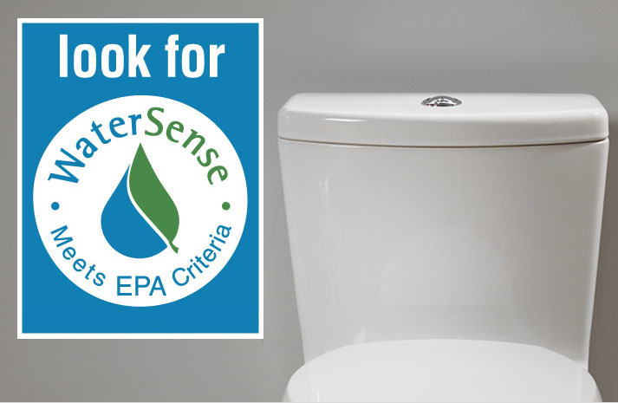
Toilet Conservation
Eco-friendly toilets use water at 1.28-0.8 gallons per flush versus 3.5 gallons per flush.
Dual flush settings
If it’s yellow…

Slide 23
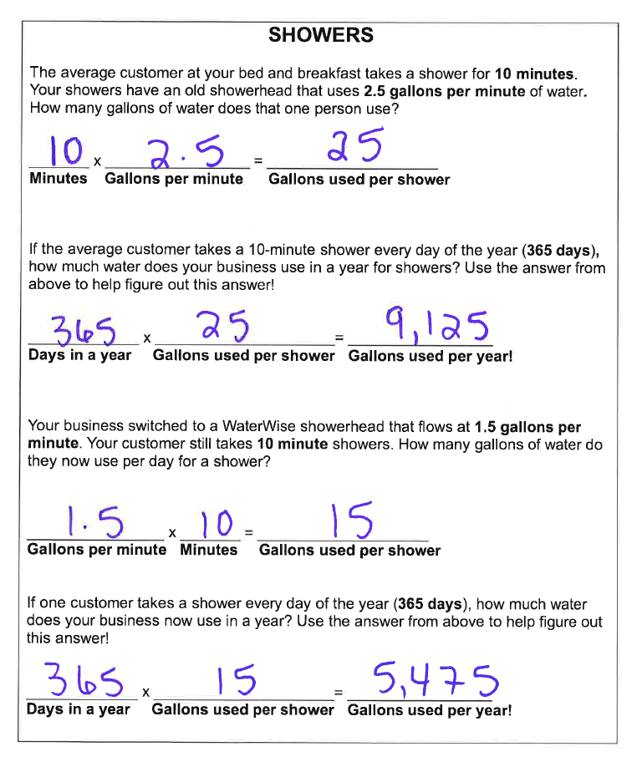
By switching to a WaterWise shower you can save 3,650 gallons of water per year!
That’s about 30 hours of continuous showering!

Slide 24
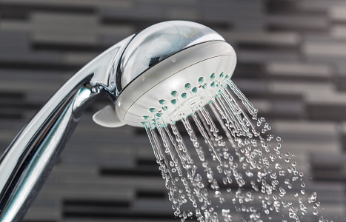
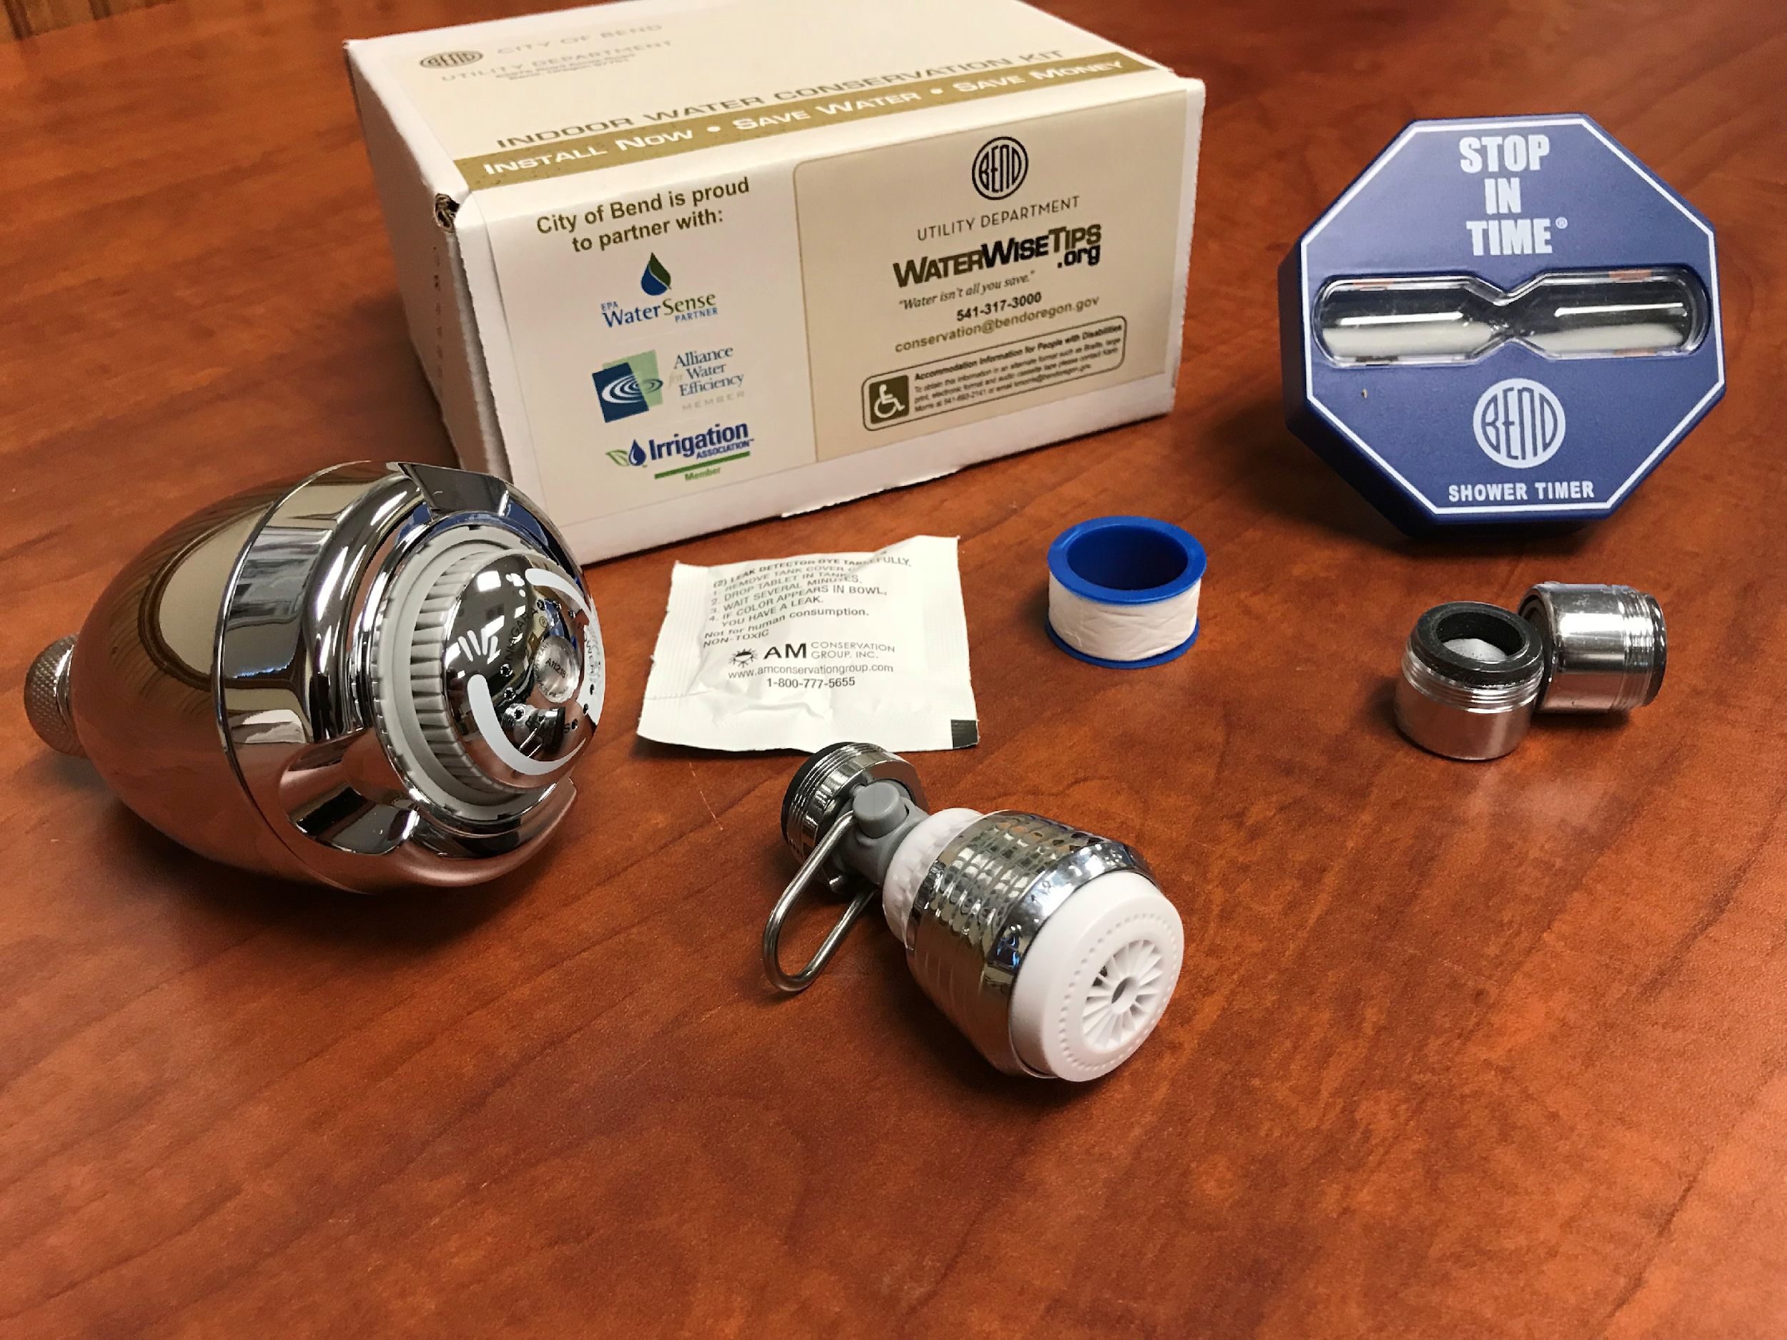
Shower Conservation
New showerhead uses water at 1.5 gallons per minute (GPM)
Shower timers can help reduce time used in the shower
2.5 GPM – 1.5 GPM = 1.0 GPM water savings every minute!

Slide 25
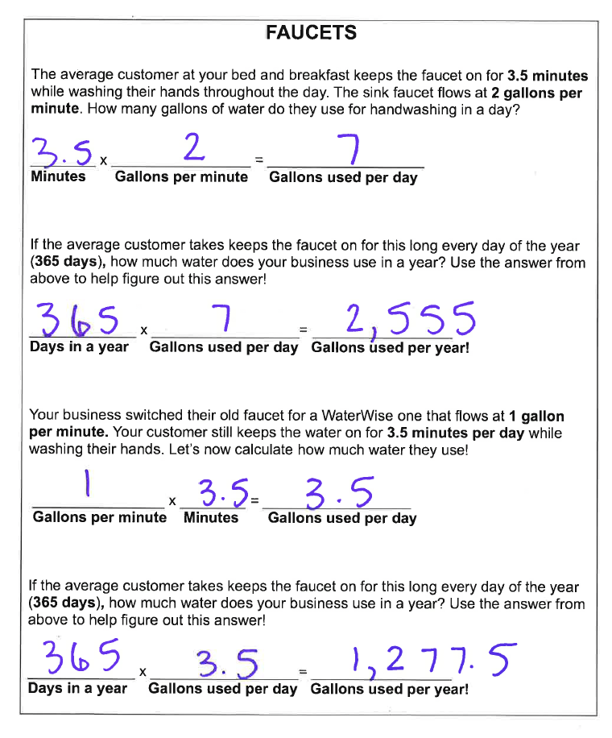
By switching to a WaterWise faucet you can save 1,327.5 gallons of water per year!
That’s about 10,211 bottles of water!

Slide 26
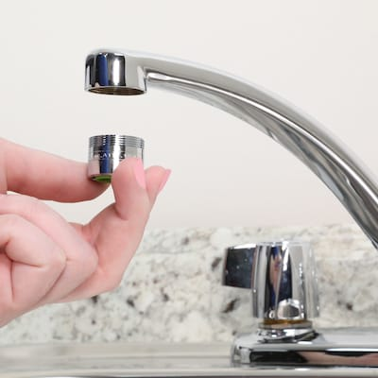
Faucet Conservation
Aerator faucet head uses water at 1-1.5 gallons per minute (GPM) vs 2 GPM on old models.
Turning off faucet when water is not needed!
Consider flow rate

Slide 27
Indoor Water Conservation Kit from the City!
Bath faucet aerators
Kitchen faucet aerator
Toilet leak detection dye tabs
5-minute shower timer
Low-flow showerhead

Slide 28
Essential Questions
Why is water considered a limited resource, even though it covers most of Earth?
How is our water use indoors connected to our local watershed?
What choices can we make to measure and reduce our indoor water use and protect our watershed?

Slide 29
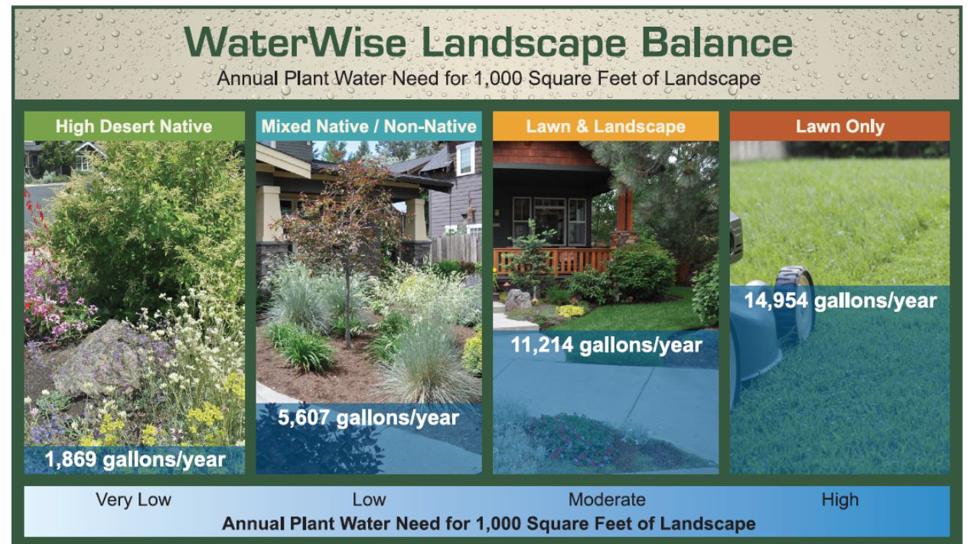
Next Lesson: Outdoor Water Conservation

Slide 30
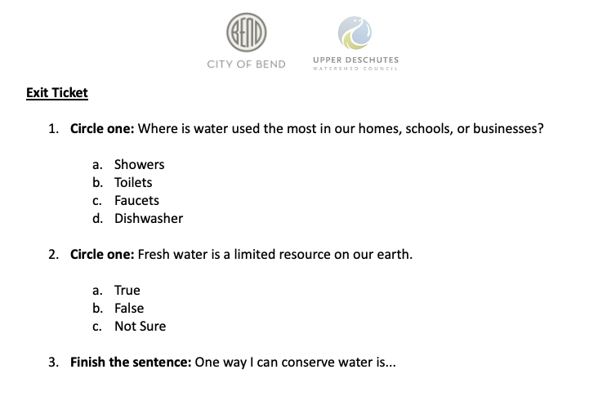
Exit Ticket

